Slide 1
Hitler’s Rise to Power
Created by:
The Birmingham Holocaust Education Committee
February 2008
Notes:
Title Slide
The rise of the Nazis defies any simple narrative. It came out of a myriad of interlacing events, ideologies and historical accidents.

Slide 2
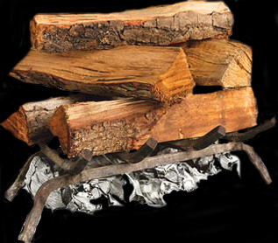
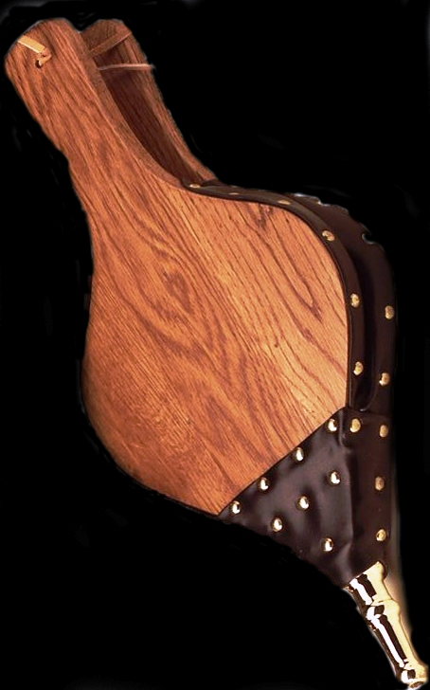
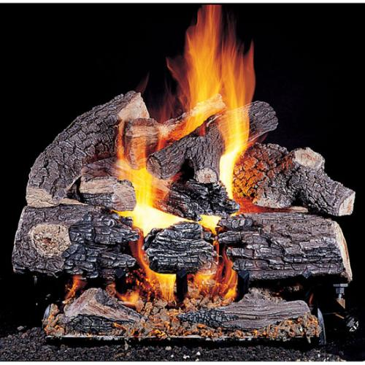
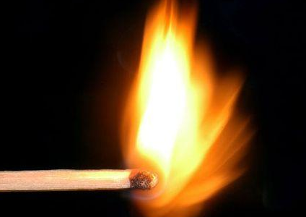
Economy
Nazi Propaganda
Antisemitism
German Nationalism
+
Adolf Hitler
The Holocaust
Notes:
Graphic of “Lighting the Match”
Some scholars believe that the Holocaust was masterminded by Adolf Hitler and was the result of long-term planning on his part. This opinion is often criticized for focusing too much on Hitler and letting everyone else off the hook.
Other scholars downplay the role of Adolf Hitler and describe the Holocaust as something that evolved over time in an improvised way. That Hitler was in fact a weak dictator, swept along by forces outside of his control.
A combination of these two viewpoints seems more in line. That Hitler was an essential factor in Nazism and the genocide it produced is without question. Without Hitler, Nazism, World War II and the Holocaust would have taken a very different form, if they had occurred at all. Yet Hitler did not have complete power – even dictators depend on popular support – and a program as massive as the crimes of Nazism required many accomplices.
If one were to think of the Holocaust as a raging fire, certain essential components or “kindling” were necessary to create that fire. Some of those were:
The existing antisemitism.
Hitler and the Nazis did not invent antisemitism. They simply reflected and built on prejudices that were familiar in many parts of Europe. A substantial part of the population had to be ready to consider it desirable, acceptable, or at least unavoidable, that certain other people would be isolated, persecuted, and killed.
2. The downturn in the German economy.
Although the Weimar Republic was not fully endorsed by the populace, without the downturn in the German economy the Nazis would have never gained power. The massive inflation and unemployment, exacerbated by the Great Depression, sent the public into a panic, searching for a quick fix.
3. The desire for a renewed German Nationalism.
After the humiliation of the Treaty of Versailles, Germany was searching for strong leadership to return them to the days of international dominance.
In order for that “kindling” to ignite, a “spark” was needed. That “spark or match” was Adolf Hitler.
Once the fire was going, it was “fueled” by the Nazi Propaganda machine.
War provided the killers with both a cover and an excuse for murder. Without the war, the Holocaust would not – and could not have happened.

Slide 3
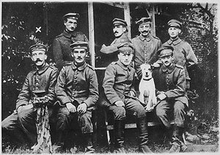
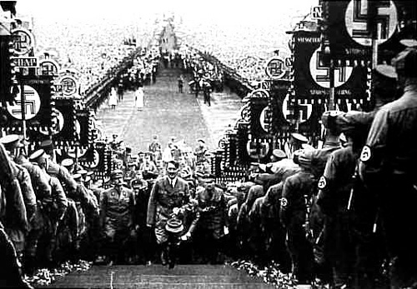
?
Adolf Hitler, Austrian Citizen, High school drop-out, Lance Corporal, German Army
Adolf Hitler, Dictator of Germany
Notes:
Graphic: How did Hitler become dictator of Germany?
How did a high school drop-out from Austria, who never rose above the rank of Lance Corporal in the German Army, become dictator of Germany and ultimately most of the European continent?

Slide 4
Myth or Fact: Adolf Hitler was elected to power.
Myth or Fact: Hitler’s rise to power was inevitable.
Notes:
Myth of Fact?

Slide 5
Hitler’s Rise to Power
The world is too dangerous to live in – not because of the people who do evil, but because of the people who sit and let it happen. – Albert Einstein
Birth of the Nazi Party
The Weimar Republic
Beer Hall Putsch (November 8-9, 1923)
Nazis Become a Legitimate Party
Hitler Appointed Chancellor (January 30, 1933)
Reichstag Fire (February 27, 1933)
Emergency Decree (February 28, 1933)
Enabling Act (March 23, 1933)
Night of the Long Knives (June 30, 1934)
Hitler Becomes Führer (August 2, 1934)
Notes:
Hitler’s Rise to Power: Breaker Slide – Birth of Nazi Party

Slide 6
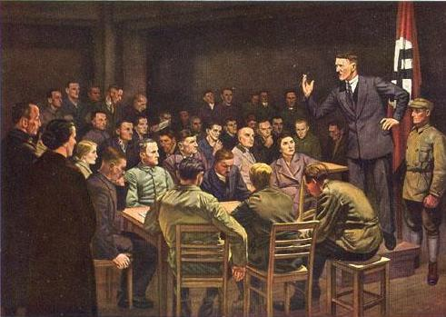
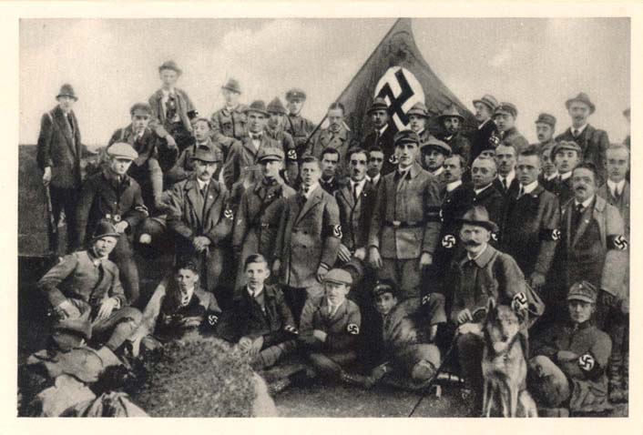
Birth of the Nazi Party
In 1919 Hitler joined the fledgling “German Worker’s Party.”
In 1920 he took control of the group and changed the name to the National Socialist German Worker’s Party, National Sozialistische Deutsche Arbeiter Partei, NSDAP, or Nazi for short.
It was here that Hitler discovered two remarkable talents: public speaking and inspiring personal loyalty.
German propaganda postcard showing an early Hitler preaching to the fledgling Nazi Party.
Assembly of the Nazi Party, 1922, Coburg, Germany
Notes:
Hitler’s Rise to Power: Birth of the Nazi Party
After World War I, Hitler stayed in the army, which was now mainly engaged in suppressing the various political uprisings that were breaking out across Germany.
In September, 1919, Corporal Hitler was ordered to investigate a small, potentially dangerous group in Munich, the German Worker’s Party. In this disorganized party, Hitler saw opportunity. Its members expressed a right-wing doctrine consistent with his own.
At the age of 30, Hitler joined as member #555 (the numbering system began at #500 to make the group appear larger). He would later become the 7th member of the Executive Committee of the party (#7 represents “completeness” in Judeo-Christian theology).
It was here that Hitler discovered that he had two remarkable talents – public oratory and inspiring personal loyalty. His pounding fists, burning eyes, hoarse cries and hysterics aroused audiences to a fevered pitch.
In 1920 Hitler took control of the group and changed the name to the National Socialist German Worker’s Party, National Sozialistische Deutsche Arbeiter Partei, NSDAP, or Nazi for short. He hoped the word “National” would attract nationalists who wanted to rebuild Germany and the word “Socialist” would attract socialists who wanted to improve the lives of working people in Germany. There were about 3,000 members.
In 1922, Major Joseph Hell, a German journalist, had the occasion to interview Adolf Hitler, and he wrote about the experience in his memoirs. Toward the end of his interview Major Hell asked Hitler, “What do you want to do to the Jews once you have full discretionary powers?” Hitler abruptly changed his demeanor, raising his voice and carrying on as if he were addressing an outdoor rally:
Once I really am in power, my first and foremost task will be the annihilation of the Jews. As soon as I have the power to do so, I will have gallows built in rows – at the Marienplatz in Munich, for example – as many as traffic allows. Then the Jews will be hanged discriminately, and they will remain hanging until they stink; they will hang there as long as the principles of hygiene permit. As soon as they have been untied, the next batch will be hung up, and so on down the line, until the last Jew in Munich has been exterminated. Other cities will follow suit, precisely in this fashion, until all Germany has been completely cleansed of Jews.
Eleven years later, on Monday, January 30, 1933, Adolf Hitler, the former Austrian corporal, was sworn in by President Paul von Hindenburg as Chancellor of Germany.

Slide 7
Hitler’s Rise to Power
The world is too dangerous to live in – not because of the people who do evil, but because of the people who sit and let it happen. – Albert Einstein
Birth of the Nazi Party
The Weimar Republic
Beer Hall Putsch (November 8-9, 1923)
Nazis Become a Legitimate Party
Hitler Appointed Chancellor (January 30, 1933)
Reichstag Fire (February 27, 1933)
Emergency Decree (February 28, 1933)
Enabling Act (March 23, 1933)
Night of the Long Knives (June 30, 1934)
Hitler Becomes Führer (August 2, 1934)
Notes:
Hitler’s Rise to Power: Breaker Slide – The Weimar Republic

Slide 8
78% favored democracy. Number of Reichstag Deputies Elected
Date | Jan 1919 | Jun 1920 | May 1924 | Dec 1924 | May 1928 | Sept 1930 | July 1932 | Nov 1932 | Mar 1933
Total Deputies | 423 | 459 | 472 | 493 | 491 | 577 | 608 | 584 | 647
SPD, Social Democrats | 165 | 102 | 100 | 131 | 153 | 143 | 133 | 121 | 120
USPD, Independent Socialists | 22 | 84
KPD, Communists |  | 4 | 62 | 45 | 54 | 77 | 89 | 100 | 81
Centre Party (Catholics) | 91 | 64 | 65 | 69 | 62 | 68 | 75 | 70 | 74
BVP, Bavarian People’s Party |  | 21 | 16 | 19 | 16 | 19 | 22 | 20 | 18
DDP, Democrats | 75 | 39 | 28 | 32 | 25 | 20 | 4 | 2 | 5
DVP, People’s Party | 19 | 65 | 45 | 51 | 45 | 30 | 7 | 11 | 2
Wirtschafts Partei, Economy Party | 4 | 4 | 10 | 17 | 23 | 23 | 2 | 1
DNVP, Nationalists | 44 | 71 | 95 | 103 | 73 | 41 | 37 | 52 | 52
NSDAP, Nazis |  |  | 32 | 14 | 12 | 107 | 230 | 196 | 288
Others | 3 | 5 | 19 | 12 | 28 | 49 | 9 | 11 | 7
Notes:
Election Chart: January 1919
In the elections of January 1919, 76% of the Germans voted for the 3 parties that favored democracy. Three parties formed a coalition:
Social Democratic Party (SPD) – remained the largest party until 1932; industrial working class
Catholic Center Party – desired to protect Catholic heritage from government interference; Catholics were 37% of the German population.
German Democratic Party (DDP) – upper middle class, university intellectuals, businessmen
In February, the elected officials met in the city of Weimar, Germany to draw up a constitution and the Weimar Republic was formed.
Many German hated the new democracy from the start. The new Republic found itself attacked from both left- and right-wing politicians.
On the left, the Communists hated the new government. They didn’t want a democracy – they wanted a ‘dictatorship of the workers’ which would bring in the Communist revolution. In January 1919 an extreme group of Communists called the Spartacists had rebelled, and there were many more Communist uprisings in the next few years.
The right-wing politicians hated the Weimar government even more. The main problem was that the German Army had not actually surrendered – the German government had. Consequently, many proud right-wing Germans (‘nationalists’) refused to believe that they had actually lost the war. They called the politicians who had signed the Armistice ‘the November Criminals’, and they were even more angry when the terms of the Treaty of Versailles became known in June 1919. There was one right-wing rebellion instigated by the Freikorps – the Kapp Putsch in Berlin in 1920 – but right-wing attacks on the government took a different form. Right-wing groups assassinated politicians and set up paramilitary groups which terrorized their neighborhoods. When the government tried to bring any of them to court, right-wing judges let them off.

Slide 9
The Weimar Republic
Now we have a Republic, the problem is we have no Republicans. - Walter Rathenau, 1st Foreign Minister of Weimar Republic
PRESIDENT
Publicly elected to 7-year term.
Head of armed forces.
Power to dismiss the government and call for new elections.
Could rule independently of Reichstag in case of national emergency.
CHANCELLOR
Appointed by President.
Usually leader of largest party in Reichstag.
REICHSTAG
Unlimited number of political parties.
Elected to 4-year term by proportional representation.
(e.g., 10% of the vote equals 10% of the seats)
421 members (1919)
647 members (1932)
CABINET
Notes:
The Weimar Republic – Organizational Chart
Questions for Discussion:
Under Article 22 of the Weimar Constitution, political parties gained seats in the Reichstag in proportion to the percentage of votes they received in national elections. Do you believe that this approach is fairer than the American system in which congressional representatives are elected in winner-take-all contests? Should a political party that wins 10% of the vote in congressional elections be entitled to 10% of the seats in Congress? Explain. What problems might arise if there were five or more parties in Congress, each supported by fewer than 20% of American voters?
2. Under the Weimar Constitution, the president served as head of state in Germany’s dealings with other countries, while the chancellor, who was appointed by the president, ran the government on a day-to-day basis. How was this different from the American system.
_________________________________________________________________
The Weimar Republic refers to the German government that was formed at Weimar, a town in the eastern part of the country, in February 1919, after Germany’s defeat in World War I. During its 14 short years, the republic would see 20 different governments in control.
The government was set up as a parliamentary democracy with a multi-party legislature known as the Reichstag. The parties were elected by proportional representation (i.e. 10% of the votes = 10% of the seats). Several parties had to come together in order to achieve a majority and pass legislation.
The new republic replaced the previous German monarchy of Kaiser Wilhelm II, who had abdicated his position and fled to Holland. From the beginning, the Weimar Republic seemed unlucky. Germans were unused to democracy, often pining for the predictable order of the monarchy. Stability seemed elusive. There were fatal weaknesses in the leadership.
President
Leading the government was a publicly elected President that served a 7-year term. His responsibilities included:
- Head of the armed forces.
- Power to choose the Chancellor and had legal right to dismiss him.
- Power to dismiss the government and call for new elections.
- Article 48 of the constitution allowed him to rule independently of the Reichstag in case of national emergency
There were only 3 Presidents of the Weimar Republic:
Friedrich Ebert – became President August 21, 1919 (SPD)
Paul von Hindenburg – elected April 27, 1925, re-elected April 10, 1932
Never convinced that democracy was right for Germany.
Adolf Hitler – self-appointed August 1934
Chancellor
Appointed by the President. Usually the leader of the most powerful elected party of the Reichstag. A Chancellor could be appointed by the President, even if he had no chance of getting the support of the Reichstag.
The Chancellor chose his own Cabinet from the elected Reichstag deputies. The Cabinet members were to be approved by the President but could be removed from office by the Reichstag. The Chancellor and the Cabinet answered to the Reichstag. Should they lose the support of the majority, a vote of no confidence was sufficient for the President to dismiss the Chancellor and either call new elections or appoint an alternative Chancellor.
Reichstag
The Reichstag was the main legislative body. They debated issues and voted on proposed legislation. Once passed by the Reichstag, the legislation would then be debated in the Reichsrat, the second German House of Parliament where it would be either ratified or rejected.
Members were elected using a system of Proportional Representation. All persons aged 20 or older could vote. Germany was divided into electoral regions. Within each of these regions a political party would put forward a number of candidates. The number of these who became deputies within the Reichstag was based on the total number of votes the party received within that electoral region. The people voted for a party, not a candidate. Party officials, not voters, decided who would fill those seats. One member could be sent for every 60,000 votes cast for the party. For this reason, the number of deputies in the Reichstag fluctuated depending on the number of voters.
The elected deputies sat in the Reichstag. The leader of the most powerful elected party would usually then be appointed Chancellor by the President. The Chancellor could then choose his own Cabinet from the elected deputies. The Chancellor and the Cabinet answered to the Reichstag, so they were reliant upon the continued support of the majority of deputies. Should they lose the support of the majority, a vote of no confidence was sufficient for the President to dismiss the Chancellor and either call new elections or appoint an alternative Chancellor.
With so many parties, it was virtually impossible for a single party to establish a majority. If no single party held power, then two or more parties could band together to form a coalition. Without a coalition, the Reichstag would be unable to pass legislation. This led to frequent changes in the government. Between 1919-1933, there were 20 separate coalition governments with the longest lasting only 2 years. This political chaos caused many to lose faith in the new democratic system.
Weaknesses of the Weimar Constitution
The Weimar Republic’s constitution safeguarded basic democratic human rights such as freedom of speech and religion and even equality for women, including their right to vote in public elections (which had not yet been given to French and English women). Yet, the Weimar Constitution was fundamentally flawed in several ways.
Proportional Voting led to too many parties.
The system of proportional representation was intended to avoid the wasting of votes. Instead it led to the rise of a multitude of splinter parties representing the ends of the political spectrum. This made it difficult for any party to establish and maintain a workable parliamentary majority. This factionalism was one contributing factor in the frequent changes in government. In the 1930 national elections, there were some 28 political parties. By 1933 there were 40!
2. Article 48. (See slide #10)
The constitution allowed the President to dismiss the Chancellor, even if the Chancellor retained the confidence of the Reichstag. Similarly, the president could appoint a Chancellor who didn’t have the support of the Reichstag. Article 48 gave the President broad powers to suspend civil liberties with an insufficient system of checks and balances. This presented an opportunity that Adolf Hitler was quick to seize one he became Chancellor.
German States had too much power.
There was an unbalanced distribution of power between the Reich and the state governments. Prussia was a disproportionately large state. Civil law enforcement was controlled by the States and not the Reich, giving Prussia a tremendous amount of power. The Republic might have been more stable with more power centralized in the hands of the Reich government.
4. Army not fully under government control. (See slide #16)
Though the Weimar Republic did not last as a government, several new laws were enacted that broke away from old traditions. Women were given the right to vote, and many new laws protected the rights of the German people. However, minority groups such as homosexuals and gypsies still faced discrimination.

Slide 10
The Weimar Constitution: Article 48
The Reich President may, if the public safety and order in the German Reich are considerably disturbed or endangered, take such measures as are necessary to restore public safety and order. If necessary, he may intervene with the help of the armed forces. For this purpose he may suspend, either partially or wholly, the Fundamental Rights (personal freedom from arrest, sanctity of home, secrecy of telephone and postal communications, free speech and free press, freedom of assembly and association, and protection of private property)…On demand of the Reichstag these measures shall be repealed.
Notes:
The Weimar Constitution: Article 48
For discussion:
Why do you think Article 48 has been called the “fatal virus” of the Weimar system?
_________________________________________________________
Article 48 granted dictatorial powers to the President in times of national emergency.

Slide 11
Parties of the Reichstag
Left: Liberal
Right: Conservative
KPD | USPD | BVP | SPD | DDP | Z | DVP | DNVP | NSDAP
Communists | Independent Socialists | Bavarian People’s Party | Social Democrats | German Democratic Party | Zentrum or Centre (Catholic) | German People’s Party | German National Party | Nazi Party
Formed 1919. Rejected Weimar Republic. |  | Branch of the Centre Party | Party with longest history (1865). Greatest supporter of demo-cracy. Workers & lower middle class support. | Liberal party formed 1918. Supported Weimar Republic. | Formed 1870 to protect Liberal Catholic interests. Supported Weimar Republic. | Most support from upper middle class & business leaders. | Formed 1918. Middle class support. | Formed 1919. Extreme nationalism and racism.
Notes:
Chart: Parties of the Reichstag
In the 1930 national elections, there were some 28 political parties. By 1933 there were 40!
KPD (Communist Party of Germany)
Founded at the time of the failed Spartacist uprising in 1919. The KPD rejected the legitimacy of the Weimar system and continually attacked its leaders. The KPD’s support was found primarily among factory workers and the unemployed in large cities. Although the KPD and the SPD directed their appeal to the working class, the two parties were bitter enemies. The KPD called for the violent overthrow of capitalism and the establishment of a workers state, as had occurred in Russia in 1917. By the late 1920’s, the KPD was closely following the direction of Josef Stalin. Like the NSDAP, the KPD had paramilitary forces numbering in the tens of thousands. These forces disrupted the meetings of their political opponents and fought street battles against the SA for control of neighborhoods. The KPD also shared the NSDAP’s attention to recruitment of young people.
USPD (Independent Socialists)
Left wing faction that split from the SPD in 1917. It was a Marxist party that sought change through parliament and social programs. oined with the Communist Party (KPD) in 1920.
BVP (Bavarian Peopole’s Party)
Founded on the principles of Catholic faith. Essentially a branch of the Centre party.
SPD (Social Democratic Party of Germany)
Founded during the latter part of the 19th century, the SPD was Germany’s largest party until 1932. Its strength was based in the growing industrial working class. The leaders of the major non-Catholic labor unions shaped SPD policies. The SPD was not a formal partner in a Weimar governing coalition after 1922. Nonetheless, the SPD was a powerful force in the Reichstag. It led efforts to pass legislation that established the 8-hour work day, laid down rules for settling employer-employee disputes, protected labor unions, and created social programs that benefited the working class. The SPD firmly rejected violent, revolutionary means to change German society. Rather, their leaders were committed to working within the system to improve the status of workers.
DDP (German Democratic Party)
Left-wing liberal party formed in 1918. Supported the new Weimar Republic and the new constitution. Mostly supported by the upper middle class and university intellectuals and businessmen.
Centre (originally called the Christian People’s Party)
Founded during the latter part of the 19th century, the Center, like its close ally, the Catholic Bavarian People’s Party (BVP), drew support largely from Germany’s Roman Catholics. Center voters came from different regions and different classes, but they were united in their desire to protect their Catholic heritage from governmental interference. Although Catholics were roughly 37% of Germany’s population, many of the Weimar Republic’s chancellors were drawn from the ranks of Center leadership. They believed in traditional family-centered religious values. They were strong supporters of democracy and the new Weimar Republic.
DVP (German People’s Party)
Devoutly right-wing and opposed the foundation of the Weimar Republic. Mostly supported by upper middle class and business leaders.
DNVP (German National Party)
Formed in 1918 and established to defend the political interests of the landed gentry. Rejected the new Republic, Treaty of Versailles and moved for democratic change. Supported by the middle class.
NSDAP (National Socialist German Workers’ Party)
Founded in Munich in 1920, the NSDAP attracted little attention at first. Like the KPD, the NSDAP rejected the legitimacy of the Weimar Republic and argued that Weimar leaders had betrayed the German people by accepting the Versailles Treaty. Their program was based on extreme nationalism, antisemitism, and condemnation of the Versailles Treaty. The party’s success was due largely to the charisma of Adolf Hitler. Because he did not become a German citizen until 1932, Hitler did not serve in the Reichstag. Instead, he remained a fiercely critical political outsider as the Weimar system unraveled.

Slide 12
Presidents of the Republic
DATE ELECTED | PRESIDENT | PARTY AFFILLIATION | OTHER
February 11, 1919 | Friedrich Ebert | SPD | Became leader of SDP in 1913. Remained President until his death.
April 27, 1925 April 10, 1932 | Paul von Hindenburg | Field Marshal (military) | No love of republics. A monarchist at heart. Remained President until his death.
August 1934 (self-appointed) | Adolf Hitler | NSDAP | Upon death of Hindenburg, Hitler combined offices of Chancellor & President.

Slide 13
45% favored democracy. Number of Reichstag Deputies Elected
Date | Jan 1919 | Jun 1920 | May 1924 | Dec 1924 | May 1928 | Sept 1930 | July 1932 | Nov 1932 | Mar 1933
Total Deputies | 423 | 459 | 472 | 493 | 491 | 577 | 608 | 584 | 647
SPD, Social Democrats | 165 | 102 | 100 | 131 | 153 | 143 | 133 | 121 | 120
USPD, Independent Socialists | 22 | 84
KPD, Communists |  | 4 | 62 | 45 | 54 | 77 | 89 | 100 | 81
Centre Party (Catholics) | 91 | 64 | 65 | 69 | 62 | 68 | 75 | 70 | 74
BVP, Bavarian People’s Party |  | 21 | 16 | 19 | 16 | 19 | 22 | 20 | 18
DDP, Democrats | 75 | 39 | 28 | 32 | 25 | 20 | 4 | 2 | 5
DVP, People’s Party | 19 | 65 | 45 | 51 | 45 | 30 | 7 | 11 | 2
Wirtschafts Partei, Economy Party | 4 | 4 | 10 | 17 | 23 | 23 | 2 | 1
DNVP, Nationalists | 44 | 71 | 95 | 103 | 73 | 41 | 37 | 52 | 52
NSDAP, Nazis |  |  | 32 | 14 | 12 | 107 | 230 | 196 | 288
Others | 3 | 5 | 19 | 12 | 28 | 49 | 9 | 11 | 7
Notes:
Election Chart: June 1920
By June 1920, the democratic parties’ share of the vote shrank to <50%.
Never again would the founding political coalition of the Weimar Republic receive more than 50% of the votes cast.
The parties on the far left and right together captured >35% of the vote in 1920. These forces rejected the basic legitimacy of the Weimar government. Throughout the Weimar period, at least 1/3 of the electorate consistently voted for parties that opposed the new republican system.
On the far left, the newly formed German Communist Party (KPD) earned 20% of the vote (this includes the USPD that merged with the KPD).
On the far right, 15% of the vote went to the German National People’s Party (DNVP). The DNVP favored a return to the social order of pre-war Germany and wanted the monarchy restored in some form. Hitler will ultimately pull the DNVP into his coalition.
Nazi Party:
The SA (brown shirts), which served as the Nazi’s private army, is organized to create unrest, break up opposition party meetings.
1923 The SS is created from members of the SA to serve as bodyguards for the Nazi leadership.

Slide 14
Inflation in Germany
DATE | GERMAN MARKS | U.S. DOLLARS
1919 | 4.2 | 1
1921 | 75 | 1
1922 | 400 | 1
Jan. 1923 | 7,000 | 1
July 1923 | 160,000 | 1
Aug. 1923 | 1,000,000 | 1
Nov. 1, 1923 | 1,300,000,000 | 1
Nov. 15, 1923 | 1,300,000,000,000 | 1
Nov. 16, 1923 | 4,200,000,000,000 | 1
Notes:
Chart: Inflation in Germany 1919-1923
By 1923, the German mark had become almost worthless:
A penny postage stamp was 5 million marks.
One egg was 80 million marks.
One pound of meat was 3.2 billion marks.
Germans lost their life savings. Hunger riots broke out.
Hitler felt the time was ripe for the Nazi party to make its move.

Slide 15
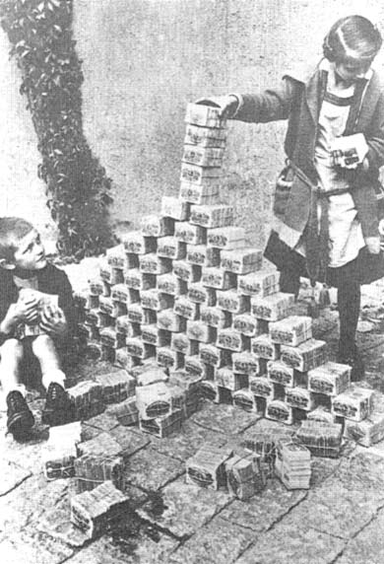
German children with stacks of inflated currency, virtually worthless in 1923.
Notes:
Photo: Children Stacking Reichmarks

Slide 16
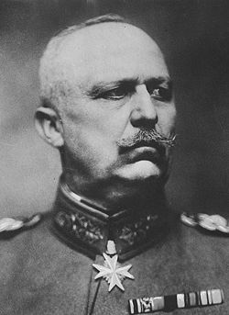
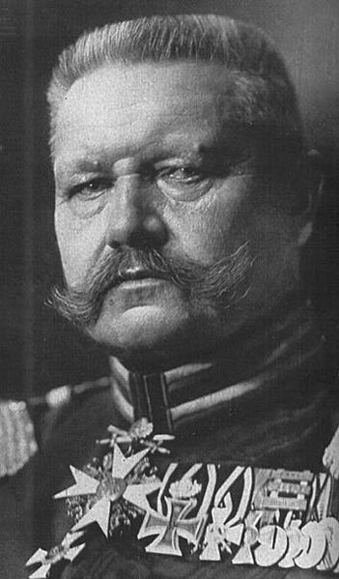
Wartime Leaders Attack the Republic
Paul von Hindenburg Oct.2, 1847 – Aug. 2, 1934 Served German Army 1866-1918
Erich Ludendorff April 9, 1865 – Dec. 20, 1937 Served German Army 1883-1918
The Weimar Republic also faced attack from the wartime leaders of the German military, most notably Field Marshals Erich von Ludendorff and Paul von Hindenburg. Both vocalized their belief that the civilian government had taken power in the final days of the war and had betrayed the armed forces by surrendering. This train of thought appealed to many Germans who could not believe their great army was on the verge of collapse in November 1918. In fact, both of these military commanders had pressed for a quick end to the war because of sinking morale among their troops.
Notes:
Wartime Leaders Attack the Republic

Slide 17
Problems faced by the Weimar Government 1919-1923
1. Ineffective Constitution
- Article 48.
- Proportional voting led to too many parties.
- German states had too much power.
- Army not fully under government control.
2. Left-wing (Communist) Rebellions
- 1919 Spartacist (communist) revolt.
3. Right-wing Terrorism
- 1920 Kapp Putsch – Freikorps brigade rebelled against Treaty of Versailles
- Nationalist terrorist groups murdered 356 politicians
- Matthias Erzberger (signed the armistice) and Walter Rathenau (SPD Foreign Minister made a treaty with Russia) assassinated.
4. Invasion - 1923, Germany failed to make reparations payment and France invaded the Ruhr (western industrial part of Germany).
5. Inflation
Notes:
Problems Faced by the Weimar Government 1919-1923
Ineffective Constitution
See slide #9.
Left-wing (Communist) Rebellions
The Communists hated the new government. They didn’t want a democracy – they wanted a ‘dictatorship of the workers’ which would bring in the Communist revolution. In January 1919 an extreme group of Communists called the Spartacists had rebelled, and there were many more Communist uprisings in the next few years.
3. Right-wing Terrorism
The right-wing politicians hated the Weimar government even more. The main problem was that the German Army had not actually surrendered – the German government had. Consequently, many proud right-wing Germans (‘nationalists’) refused to believe that they had actually lost the war. They called the politicians who had signed the Armistice ‘the November Criminals’, and they were even more angry when the terms of the Treaty of Versailles became known in June 1919. There was one right-wing rebellion – the Kapp Putsch in Berlin in 1920 – but right-wing attacks on the government took a different form. Right-wing groups assassinated politicians and set up paramilitary groups which terrorized their neighborhoods. When the government tried to bring any of them to court, right-wing judges let them off.
4. Invasion
Things came to a head in 1923, when Germany defaulted on a payment and the French invaded the Ruhr (the industrial part of Germany) and started to take the money in the form of coal and manufactured goods. Outraged, the Germans in the Ruhr went on strike and to help them the government promised to pay their wages anyway. How did it do this – it simply printed off paper money and gave it to the strikers.
5. Inflation
In those days they didn’t understand how the economy works, and they didn’t realize what would happen if they stopped producing and started printing more money. The result was hyperinflation – prices rose out of control. Some people made huge fortunes, but other were ruined. See slides #14,15.
Gustav Stresemann (DVP), who became Chancellor in August 1923 (until November 1923), is usually credited with ‘saving’ Germany. The most important thing he did was to organize an alliance of the moderate, pro-democratic parties. This meant, for the first time, that the government could get a majority in the Reichstag and pass the laws it wanted.
Stresemann sorted out Germany’s economic problems.
On November 15, 1923, he called in the old worthless money (Rerichmark) and replaced them with a new currency (the Rentenmark). (1 trillion Reichmarks = 1 Rentenmark)
In 1924 he arranged $200 million loan from the American Vice-President Charles Dawes – which got German industry going. This was known as the Dawes Plan (August 1924). Reparation payments resumed but were tied to Germany’s ability to pay.
Stresemann also built new housing, and set up Labour exchanges to pay money to the unemployed. He became hugely popular, and the ‘roaring twenties’ came to Germany – these were the days of great creativity in architecture (Walter Gropius and the Bauhaus school of architecture), art (Paul Klee and Otto Dix), Books (Erich Maria Remarque) and films and cabaret (Marlene Dietrich).
In 1925 he signed the Locarno Treaties (October 1925) with the Allied countries as a means of restoring Germany’s diplomatic status in Europe. With this, the Ruhr was returned to Germany, Germany’s western borders were recognized, the strike was called off, and reparation payments began.
Germany was allowed to join the League of Nations in 1926.
Gustav Stresemann’s death in 1929 marked the end of the “Golden Era” of the Weimar Republic. He died at the age of 51, four years after receiving the 1926 Nobel Peace Prize.

Slide 18
Hitler’s Rise to Power
The world is too dangerous to live in – not because of the people who do evil, but because of the people who sit and let it happen. – Albert Einstein
Birth of the Nazi Party
The Weimar Republic
Beer Hall Putsch (November 8-9, 1923)
Nazis Become a Legitimate Party
Hitler Appointed Chancellor (January 30, 1933)
Reichstag Fire (February 27, 1933)
Emergency Decree (February 28, 1933)
Enabling Act (March 23, 1933)
Night of the Long Knives (June 30, 1934)
Hitler Becomes Führer (August 2, 1934)
Notes:
Hitler’s Rise to Power: Breaker Slide – Beer Hall Putsch

Slide 19
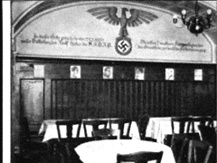
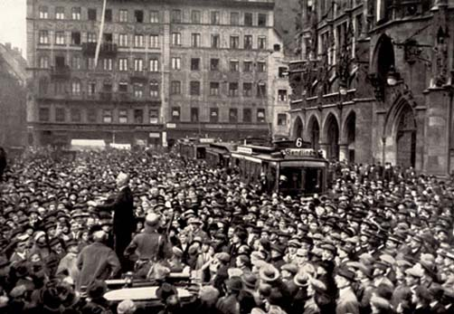
Beer Hall Putsch
November 8-9, 1923
Part of a photo-card collection used by the Nazis to indoctrinate German children. The Bürgerbräukeller Beer Hall in Munich was the scene of the failed Nazi Putsch. It symbolized the birth pangs of Nazi power.
Munich, Germany, 1923, Masses in the streets during the Putsch.
Notes:
Beer Hall Putsch, November 8-9, 1923
Teacher Note:
Putsch – German word that means a secretly planned and suddenly executed attempt to overthrow a government
____________________________________________________________________________
In January 1923, French and Belgium troops occupied the Ruhr region of Germany in order to demand payment of reparations. In addition, hyperinflation created widespread discontent and criticism of the Weimar government. Right wing groups realized that the Weimar government was not doing enough to protect the German state. Hitler felt it was imperative to act before the government re-established order.
With a group of ex-soldiers, including war-time ace Hermann Goering and Field Marshall Erich von Ludendorff, the Nazis plotted to seize control of Munich, the capital of Bavaria, and then stage a march on Berlin.
On November 8, Adolf Hitler, Hermann Goering, and Erich von Ludendorff, backed by the SA, stormed into the Bügerbräukeller Beer Hall in the city of Munich in Bavaria (a German state) where Bavarian officials were meeting with 3,000 businessmen. They kidnapped the Prime Minister and dramatically announced that the National Revolution had begun.
The next day Hitler hoped to take over the Bavarian government buildings by force and ultimately move on to the remainder of the German states. Hitler and his comrades were confronted by the Bavarian police. During the ensuing battle, 16 Nazis and 4 policemen were killed. Ludendorff was arrested but later acquitted. Hitler was wounded and whisked away by comrades. He was arrested 2 days later and charged with treason. Ernst Roehm had tried to take over the Bavarian War Ministry across town, but also failed.
At first Hitler considered the Putsch a disaster; hysterically, he contemplated suicide. He soon recovered and used the ensuing trial as a vehicle for a propaganda attack on the hated democratic regime. Hitler was sentenced to 5 years in Landsberg Prison but served only 9 months.*
* The judge in the trial was a Nazi sympathizer and thus lessened the sentence.
Every November, Hitler and his cronies re-enacted the aborted putsch, pausing at a memorial that honored the “martyrs” that died.
Chancellor Gustav Stresemann (DVP, People’s Party) was severely criticized by members of the Social Democratic Party (SPD) and Communist Party over his unwillingness to deal firmly with Adolf Hitler and other Nazi Party leaders after the failure of the Beer Hall Putsch. Later that month the socialists withdrew from Stresemann's government and he was forced to resign as chancellor (November 1923).

Slide 20
Hitler’s Rise to Power
The world is too dangerous to live in – not because of the people who do evil, but because of the people who sit and let it happen. – Albert Einstein
Birth of the Nazi Party
The Weimar Republic
Beer Hall Putsch (November 8-9, 1923)
Nazis Become a Legitimate Party
Hitler Appointed Chancellor (January 30, 1933)
Reichstag Fire (February 27, 1933)
Emergency Decree (February 28, 1933)
Enabling Act (March 23, 1933)
Night of the Long Knives (June 30, 1934)
Hitler Becomes Führer (August 2, 1934)
Notes:
Hitler’s Rise to Power: Breaker Slide – Nazis Become a Legitimate Party

Slide 21
Nazis appear in Reichstag. Number of Reichstag Deputies Elected
Date | Jan 1919 | Jun 1920 | May 1924 | Dec 1924 | May 1928 | Sept 1930 | July 1932 | Nov 1932 | Mar 1933
Total Deputies | 423 | 459 | 472 | 493 | 491 | 577 | 608 | 584 | 647
SPD, Social Democrats | 165 | 102 | 100 | 131 | 153 | 143 | 133 | 121 | 120
USPD, Independent Socialists | 22 | 84
KPD, Communists |  | 4 | 62 | 45 | 54 | 77 | 89 | 100 | 81
Centre Party (Catholics) | 91 | 64 | 65 | 69 | 62 | 68 | 75 | 70 | 74
BVP, Bavarian People’s Party |  | 21 | 16 | 19 | 16 | 19 | 22 | 20 | 18
DDP, Democrats | 75 | 39 | 28 | 32 | 25 | 20 | 4 | 2 | 5
DVP, People’s Party | 19 | 65 | 45 | 51 | 45 | 30 | 7 | 11 | 2
Wirtschafts Partei, Economy Party | 4 | 4 | 10 | 17 | 23 | 23 | 2 | 1
DNVP, Nationalists | 44 | 71 | 95 | 103 | 73 | 41 | 37 | 52 | 52
NSDAP, Nazis |  |  | 32 | 14 | 12 | 107 | 230 | 196 | 288
Others | 3 | 5 | 19 | 12 | 28 | 49 | 9 | 11 | 7
Notes:
Election Chart: May 1924
In May 1924, shortly after the drama of the failed Munich Putsch (November 1923), the NSDAP earned seats in the Reichstag for the first time. They won only 6.6% of the vote. Hitler was still in prison.
The increase in the KPD was due to the dissolution of the USPD.
The new government was led by Chancellor Wilhelm Marx, ex-Chancellor Stresemann was appointed foreign minister. Stresemann negotiated the Dawes Plan (1924) which resulted in the French Army withdrawing from the Ruhr.
Hitler was released from prison on December 20, 1924. Hitler asserted himself as the Leader of the party, a critical move since there had been a number of challenges to his leadership while he was in prison.
In the months after his release, Hitler re-founded the Nazi Party, vowing to work within the Constitution. He realized that in the future he must not go against military forces. He needed to rebuild the Nazi party as a legitimate political party with a national organization. He would work within the existing system, relying on propaganda and mobilizing the masses. He would need to seize power constitutionally rather than by force.
In contrast, Ernst Roehm, a commanding force in the SA who had taken part in the putsch, continued to believe that the use of paramilitary force was the most effective strategy for staging “a national revolution.” This will become a problem later on.
The Nazis rebuilt the party in many ways:
They managed to get huge funding from rich businessmen (including the German steel bosses Krupp and Thyssen, the German car firms Opel and Skoda, and the American businessmen Henry Ford) who thought the Nazis would stop Communism.
They developed brilliant propaganda (organized by Josef Goebbels) and used the most modern technology (radio, newspapers and airplanes) to get their ideas across. They used some communist ideas (e.g. state control of industry/ land to the small farmers/ better pensions) to gain the support of the working classes.
They set up youth clubs (Hitler Youth) which began indoctrinating young people to believe the Nazi message.
Adolf Hitler was a brilliant speaker, and his book – Mein Kampf – became a best seller.

Slide 22
Nazis < 3% of Reichstag. Number of Reichstag Deputies Elected
Date | Jan 1919 | Jun 1920 | May 1924 | Dec 1924 | May 1928 | Sept 1930 | July 1932 | Nov 1932 | Mar 1933
Total Deputies | 423 | 459 | 472 | 493 | 491 | 577 | 608 | 584 | 647
SPD, Social Democrats | 165 | 102 | 100 | 131 | 153 | 143 | 133 | 121 | 120
USPD, Independent Socialists | 22 | 84
KPD, Communists |  | 4 | 62 | 45 | 54 | 77 | 89 | 100 | 81
Centre Party (Catholics) | 91 | 64 | 65 | 69 | 62 | 68 | 75 | 70 | 74
BVP, Bavarian People’s Party |  | 21 | 16 | 19 | 16 | 19 | 22 | 20 | 18
DDP, Democrats | 75 | 39 | 28 | 32 | 25 | 20 | 4 | 2 | 5
DVP, People’s Party | 19 | 65 | 45 | 51 | 45 | 30 | 7 | 11 | 2
Wirtschafts Partei, Economy Party | 4 | 4 | 10 | 17 | 23 | 23 | 2 | 1
DNVP, Nationalists | 44 | 71 | 95 | 103 | 73 | 41 | 37 | 52 | 52
NSDAP, Nazis |  |  | 32 | 14 | 12 | 107 | 230 | 196 | 288
Others | 3 | 5 | 19 | 12 | 28 | 49 | 9 | 11 | 7
Notes:
Election Chart: December 1924, May 1928 (the Quiet Years)
By December 1924, German hyperinflation was under control.
The old reichmarks were burned and new notes known as rentenmarks (valued a 1 trillion marks) were issued.
Germany had borrowed money from the U.S. via the Dawes Plan to help pay back reparations as well as finance new social programs and building programs.
The old standby SPD (Social Democrats) showed an increase, from 131 to 153.
The Nationalists (CNVP) sustained a clear defeat, dropping from 103 to 73.
The NSDAP achieved < 3% of the Reichstag in 1924 and 1928, in part because the German people were content with the status quo…but not for long.
The dominant political fight was among the major parties themselves and not against the NSDAP, which few people looked upon as a serious movement. In fact, most politicians thought the Nazis were just another temporary expression of racist extremism.
In 1925, Field Marshal Paul von Hindenburg, a conservative military hero, was elected President of the Republic. The first four years of Hindenburg’s rule marked the high point of the Weimar Republic. In 1926, Germany entered the League of Nations. Economically, the country was stabilizing.
Hans Luther became Chancellor (January 1925 – May 1926). Gustav Stresemann's (Foreign Minister 1923 – 1929) skilled statesmanship led to the Locarno Treaty (December, 1925), the German-Soviet Treaty (April, 1926) and Germany joining the League of Nations in 1926. Later that year, Stresemann was awarded the Nobel Peace Prize.

Slide 23
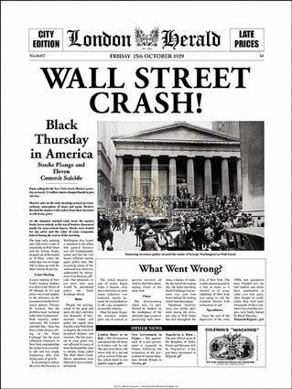
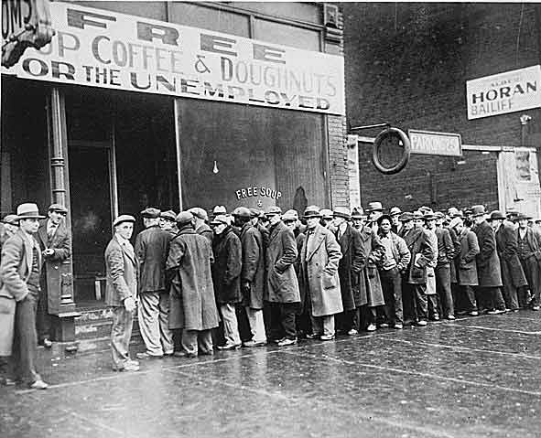
Worldwide Depression, 1929
Bread lines for the unemployed in the U.S.
Notes:
Worldwide Depression, 1929
All seemed on the road to recovery until October 1929 when Wall Street crashed and U.S. banks closed. The Great Depression hit.
Germany had taken huge loans from U.S. banks in order to pay their war reparations as well as finance German industrial expansion. Suddenly the banks called in their loans and the Germans were worse off than before.
The crisis of the Great Depression created the instability that Hitler needed. He would provide the stability that Germany longed for. Unlike the Beer Hall Putsch where the Nazis tried to take power by force, power would be achieved by legal means this time.
The crisis of The Depression brought disunity to the political parties of the Reichstag. As economic conditions in Germany worsened, Hitler and the Nazi party attracted a wider following from many different sectors of society. Unskilled and/or unemployed manual laborers and office workers were lured by promises of new and better jobs. Soldiers and policemen responded to promises of increased personnel and improvements in equipment and benefits. Doctors, lawyers and businessmen were attracted by the prospect of benefiting from the confiscation of Jewish assets or the elimination of Jewish competition. Students were lured by the promise of more jobs and better careers. Farmers looked to the Nazis to bolster agricultural prices. Unlike the existing political parties, the NSDAP had no proven track record of failure and therefore offered hope.
The NSDAP stands for the opposite of what exists today. - Gregor Strasser

Slide 24
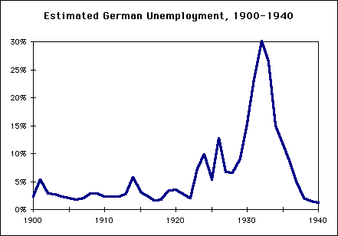
Unemployment in Germany 1928-1933
September 1928 | 650,000
September 1929 | 1,320,000
September 1930 | 3,000,000
September 1931 | 4,350,000
September 1932 | 5,102,000
January 1933 | 6,100,000
Notes:
Unemployment in Germany 1928-1933
Note the steady rise in unemployment after World War I (1919) and then the massive jump after the “Crash of 1929.” This provided the open door that Hitler needed.
After Hitler came to power (1933) he came through with his promise of jobs. Notice the decline in unemployment.

Slide 25
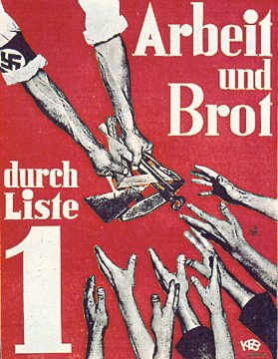
The Nazi Party, political unknowns, promised the German people a solution to their hunger and poverty: Work & Bread.
After the Nazis came to power, public works programs similar to those initiated by FDR’s “New Deal” stimulated the German economy.
Prior to World War II, average Germans credited the Nazis with their improved standard of living.
“Work and Bread!” Nazi Party election poster from the early 1930’s.
Notes:
Nazi Election Poster - Work & Bread
In preparation for the parliamentary elections of 1930, the NSDAP waged a whirlwind campaign. They shifted their strategy to rural areas and fueled antisemitism by calling for the expropriation of Jewish agricultural property and by condemning large Jewish department stores.

Slide 26
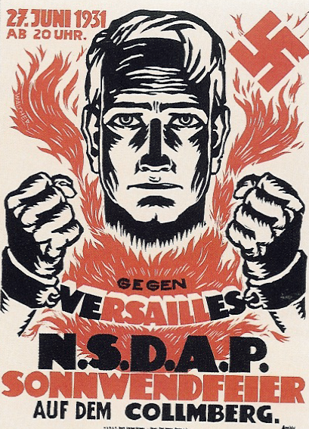
Nazi propaganda poster illustrating the Nazi’s desire to break the shackles of the Treaty of Versailles.
Notes:
Nazi Election Poster – Aryan in Shackles
The NSDAP also capitalized on German resentment of the Treaty of Versailles. In this poster, note the Aryan male image, the fire as a symbol of force/destruction, the “Versailles shackles” that the NSDAP (Nazis) wanted to burn apart.

Slide 27
NSDAP 2nd largest party (18%). Number of Reichstag Deputies Elected
Date | Jan 1919 | Jun 1920 | May 1924 | Dec 1924 | May 1928 | Sept 1930 | July 1932 | Nov 1932 | Mar 1933
Total Deputies | 423 | 459 | 472 | 493 | 491 | 577 | 608 | 584 | 647
SPD, Social Democrats | 165 | 102 | 100 | 131 | 153 | 143 | 133 | 121 | 120
USPD, Independent Socialists | 22 | 84
KPD, Communists |  | 4 | 62 | 45 | 54 | 77 | 89 | 100 | 81
Centre Party (Catholics) | 91 | 64 | 65 | 69 | 62 | 68 | 75 | 70 | 74
BVP, Bavarian People’s Party |  | 21 | 16 | 19 | 16 | 19 | 22 | 20 | 18
DDP, Democrats | 75 | 39 | 28 | 32 | 25 | 20 | 4 | 2 | 5
DVP, People’s Party | 19 | 65 | 45 | 51 | 45 | 30 | 7 | 11 | 2
Wirtschafts Partei, Economy Party | 4 | 4 | 10 | 17 | 23 | 23 | 2 | 1
DNVP, Nationalists | 44 | 71 | 95 | 103 | 73 | 41 | 37 | 52 | 52
NSDAP, Nazis |  |  | 32 | 14 | 12 | 107 | 230 | 196 | 288
Others | 3 | 5 | 19 | 12 | 28 | 49 | 9 | 11 | 7
Notes:
Election Chart: September 1930
Prior to these elections, Dr. Heinrich Brüning became Chancellor in March 1930 (until March 1932). He was an economist by training and a member of the Catholic Center Party.
While the economy had been expanding, the government was able to keep up with the cost of providing benefits to unemployed workers and other social programs. Now, with the economic downturn, German leaders were caught in a dilemma. To balance the budget, they would either have to cut benefits or raise taxes on employers. As defenders of the working class, the SPD fought against cuts in social programs, while the conservative parties opposed higher taxes. The government was deadlocked and the German budget deficit ballooned.
The SPD did not have a solution to the economic problems.
In March 1930, the “grand coalition” (SPD, Centre, DDP) “collapsed.” The economic issues were so volatile and the parliamentary situation so insecure, that Brüning agreed to govern by emergency decree provided for in Article 48 of the Constitution. A host of legislation was issued under the signature of the President and countersignature of the Chancellor. The Reichstag was quickly dissolved in order to prevent a vote of no confidence. Brüning’s intent was honorable, but he set a very dangerous precedent. He used the emergency clause in a situation that was not the kind of military or foreign-induced emergency the constitution writers had in mind. Article 48 was not planned as a political expedient.
Internationally, Germany was unable to pay reparations to the Allies. In response, U.S. President Herbert Hoover called for a temporary halt to the payments.
In the streets, organized violence by paramilitary groups, such as the SA of the NSDAP and their counterparts in the Nazi Party, became a regular feature of German politics. Extremists of both the right and the left attempted to intimidate their opponents and dominate neighborhoods.
With millions unemployed, thousands of failed businesses, homelessness and starvation rampant, the people wanted answers. From their elected leaders, the people got nothing but indecision.
New elections were called.
In the elections of September 1930, the people wanted something new. The parties of the extreme left and right showed dramatic gains.
The KPD polled 1.3 million more votes than they had two years earlier.
The NSDAP became the 2nd largest party, with 18% of the seats in the Reichstag. The results sent shock waves through the political system.
Part of the reason for the Nazi landslide could be found in the constitution itself, namely the provision for proportional representation. Under this system, a percentage of the seats in the Reichstag were assigned to a party based on the total percentage of the popular vote that party received. In no district did they poll more than 40% of the vote. Their national popular vote of 18.3% gave them 107 deputies. If this had been a voting by single person constituencies, the NSDAP could not have won much more than about 20 seats.
The Nazi deputies had no intention of cooperating with the democratic government. It was to their advantage to let things get worse in Germany, thus increasing the appeal of Hitler to an ever more miserable people.
Some 50 decrees were issued during Brüning’s 2-year chancellorship. All but 12 dealt with economic and financial crisis.
The bulk of German capitalists and land-owners originally gave support to this conservative experiment: not from any personal liking for Brüning, but believing the conservatives would best serve their interests. As the mass of the working class and middle class turned against Brüning, more of the capitalists and landowners declared themselves in favor of his opponents – Hitler and Hugenberg (DNVP, Nationalists). By late 1931, conservatism as a movement was dead.

Slide 28
Chancellors of the Republic
CHANCELLOR | APPOINTED | LEAVES OFFICE | POLITICAL PARTY | COALITION | NAT’L. ELECTION
Friedrich Ebert | Nov. 1918 | Feb. 1919 | SPD | SPD, Center, DDP | Jan. 1919
Philipp Scheidemann* | Feb. 1919 | June 1919 | SPD | SPD, Center, DDP
Gustav Bauer | June 1919 | March 1920 | SPD | SPD, Center, DDP
Hermann Müller | March 1920 | June 1920 | SPD | SPD, Center, DDP
Konstantin Fehrenbach | June 1920 | May 1921 | Center | Center, DDP, DVP | June 1920
Josef Wirth | May 1921 | Nov. 1922 | Center | Center, DDP SPD
Wilhelm Cuno | Nov. 1922 | August 1923 | none | Center, DDP, DVP
Gustav Stresemann | August 1923 | Nov. 1923 | DVP | Rule by Decree
Wilhelm Marx | Nov. 1923 | Dec. 1924 | Center | Center, DDP, DVP, BVP | May 1924
Dr. Hans Luther | Jan. 1925 | May 1926 | none | Center, DDP, DVP, BVP | Dec. 1924
Wilhelm Marx | May 1926 | June 1928 | Center | Center, DDP, DVP, BVP
Hermann Müller | June 1928 | March 1930 | SPD | SPD, DDP, Center, BVP | May 1928
Dr. Heinrich Brüning | March 1930 | March 1932 | Center | Rule by Decree | Sept. 1930
Franz von Papen | March 1932 | Nov. 1932 | Center | Rule by Decree | July 1932
Kurt von Schleicher | Dec. 1932 | Jan. 1933 | None | Rule by Decree | Nov. 1932
Adolf Hitler | Jan. 1933 |  | NSDAP | Rule by Decree | March 1933
* Scheidemann is considered 1st Chancellor of Weimar Republic
Notes:
Chart: Chancellors of the Republic
Note that after Mueller, the “Grand Coalition” had collapsed.
For the next three years, no leadership could restore a majority coalition. The various Chancellors called upon President Hindenburg to invoke Article 48 of the Constitution, allowing the Chancellor to rule by decree in an emergency situation. Germany ceased to be a parliamentary regime. A form of presidential dictatorship replaced Weimar’s parliamentary democracy.

Slide 29
Hitler Runs for President March 13, 1932
February 25, 1932 Hitler becomes naturalized German citizen.
_________________________________
March 13, 1932 Hitler 30%, Hindenburg 49%
April 10, 1932 (runoff) Hitler 37%, Hindenburg 53%
Notes:
Hitler Runs for President: March 13, 1932
Runoff Election: April 10, 1932
In order to run in the Presidential election, Hitler became a naturalized German citizen on February 25, 1932.
In March 1932, Hitler made his first attempt to run for President of Germany.
It was thought that Hitler could be stopped by re-electing President Hindenburg. Chancellor Brüning persuaded Hindenburg to run for re-election against Hitler. Hindenburg would have been 92 at the end of another 7-year term. He ran simply to prevent Hitler from taking over. The Social Democrats and Democrats supported Hindenburg as the lesser evil. A vote for Hindenburg was a vote to continue the German Republic. A vote for Hitler was a vote against the Republic.
1. No one received a majority in the March 13 election (Hindenburg 49%, Hitler 30%) and a runoff was required.
Before the April runoff election, Hitler became the first politician to make use of an airplane for campaigning.
In April, the voters re-elected President Hindenburg by a clear majority (Hindenburg 53%, Hitler 37%). The voters declared their preference for a democratic republic. Even though he lost, Hitler had picked up an additional 2 million votes.
Hitler’s strong showing in the presidential race was a reflection of the NSDAP’s growing political sophistication. By the early 30’s the Nazis had set up local party organizations in towns and cities throughout Germany. They had also learned to tailor their propaganda to win over specific groups and regions.

Slide 30
The Intrigue Begins (The Schleicher-Hitler Agreement)
April 13, 1932: Due to growing Nazi violence, Chancellor Heinrich Brüning invokes Article 48 and bans the SA and SS.
May 8, 1932: General Kurt von Schleicher, wanting to lead Germany himself, holds a secret meeting with Hitler proposing lifting the ban on the SA and SS, dissolving the Reichstag, holding new elections, and dumping Chancellor Brüning if Hitler would support his government. Hitler agrees.
May 29, 1932: Chancellor Brüning is forced to resign, effectively ending democracy in Germany.
Notes:
The Intrigue Begins (The Schleicher-Hitler Agreement)
April 13, 1932:
After the April 10 election, there was a noticeable increase in Nazi violence. By now there were now over 400,000 storm troopers under the leadership of SA Chief Ernst Röhm. Many in the German democratic government came to believe the SA were about to take over by force. Many SA members saw themselves to be a true revolutionary army. Hitler had to reign them in from time to time so they wouldn’t upset his carefully laid plans to undermine the republic. Hitler knew he could not succeed as leader of Germany without the support of existing institutions such as the German Army and the powerful German industrialists, both of whom were keeping an eye on the SA.
Three days after the election, in response to this growing Nazi violence, Chancellor Heinrich Brüning (appointed March 1930) persuaded President Hindenburg of the need to ban the SA. Hindenburg invoked Article 48 and the SA and SS was banned across Germany. The Nazis were outraged and wanted Hitler to fight the ban. But Hitler, always a step ahead, knew better. He agreed to the ban knowing that opportunity would soon come along.
Brüning was one of the last men in Germany who stood up to Hitler with the best interest of the people at heart. He had been responsible for Hindenburg’s re-election and the keeping of Hitler out of the government. He was also working on the international scene to try to help the German economy by seeking an end to war reparations. His economic policies at home, however, brought dismal results and severely polarized the electorate.
May 8, 1932:
Hitler’s opportunity did come along in the form of General Kurt von Schleicher, a scheming army officer who wanted to lead Germany himself.
Schleicher became a major figure behind the scenes in the cabinet of Chancellor Heinrich Brüning between 1930 and 1932, serving as an aid to the Minister of Defense. He established a close relationship with President Hindenburg.
Schleicher wanted to lead Germany himself. He wanted to impose a permanent authoritarian right-wing government independent of the Reichstag and backed by the army. To that end, he held a secret meeting with Hitler proposing lifting the ban on the SA and SS, dissolving the Reichstag, holding new elections, and dumping Chancellor Brüning if Hitler would support his government. Hitler agreed.
In the eyes of Schleicher and Hitler, Brüning was in the way and had to go. Schleicher went to work undermining Brüning’s position w/ Hindenburg. Brüning was already in trouble with Hindenburg. Hindenburg blamed Brüning for making him run for re-election against Hitler at age 85.
May 29, 1932:
Hindenburg was fed up with issuing unpopular decrees on Brüning’s behalf. In 1932, President Hindenburg issued 66 presidential emergency decrees while the Reichstag passed only 5 laws through the legislature. Germany’s economic situation had gotten so bad, with nearly 6 million unemployed, that Brüning was labeled the “Hunger Chancellor.” Chancellor Brüning was forced to resign, effectively ending democracy in Germany.
At this point, Schleicher probably though he would be appointed Chancellor….

Slide 31
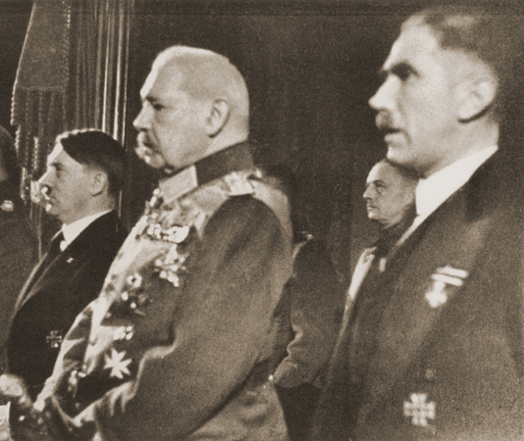
Franz von Papen Appointed Chancellor June 1, 1932
June 14, 1932 Papen lifts ban on SA and SS
July 17, 1932 “Bloody Sunday”
(Papen) enjoyed the peculiarity of being taken seriously by neither his friends nor his enemies. He was reputed to be superficial, blundering, untrue, ambitious, vain, crafty and an intriguer.
- André François-Poncet, French Ambassador to Berlin
Left to Right: Hitler, Hindenburg, Papen
Notes:
Franz von Papen Appointed Chancellor: June 1, 1932
Franz von Papen, a Catholic nobleman, was plucked from relative obscurity when President Hindenburg appointed him Chancellor. He replaced Brüning, a fellow Centre Party politician. Papen owed his political career to his friendship with President Hindenburg, for most agreed he was remarkably incompetent. According to the French Ambassador in Berlin, André François-Poncet, Papen “enjoyed the peculiarity of being taken seriously by neither his friends nor his enemies. He was reputed to be superficial, blundering, untrue, ambitious, vain, crafty and an intriguer.”
The cabinet which Papen formed, with the assistance of General Kurt von Schleicher, was known as the "cabinet of barons" and was widely regarded with ridicule by Germans. Schleicher was appointed Minister of Defense. Except for the conservative DNVP, Papen had practically no support in the Reichstag— he had never been elected to the legislative body.
Papen ruled in an authoritarian manner.
In an effort to win Nazi support, Papen reiterated Schleicher’s previous under-handed offer to Hitler to lift the ban on the SA and SS and call for new elections if the NSDAP would join his coalition. Hitler agreed, Papen fell for the trap, and the Reichstag was dissolved on June 4 with new elections called for July 1932.
On June 14, Papen lifted the ban on the SA and SS as promised. Murder and violence erupted all over Germany. On July 17 (known as “ Bloody Sunday”), a big shoot-out occurred in a Communist area near Hamburg: 19 killed and nearly 300 wounded. Papen invoked Article 48 and declared martial law in Berlin. He also took over the government of the state of Prussia.
Hitler decided Papen had to go.

Slide 32
Nazis largest party (37%). Number of Reichstag Deputies Elected
Date | Jan 1919 | Jun 1920 | May 1924 | Dec 1924 | May 1928 | Sept 1930 | July 1932 | Nov 1932 | Mar 1933
Total Deputies | 423 | 459 | 472 | 493 | 491 | 577 | 608 | 584 | 647
SPD, Social Democrats | 165 | 102 | 100 | 131 | 153 | 143 | 133 | 121 | 120
USPD, Independent Socialists | 22 | 84
KPD, Communists |  | 4 | 62 | 45 | 54 | 77 | 89 | 100 | 81
Centre Party (Catholics) | 91 | 64 | 65 | 69 | 62 | 68 | 75 | 70 | 74
BVP, Bavarian People’s Party |  | 21 | 16 | 19 | 16 | 19 | 22 | 20 | 18
DDP, Democrats | 75 | 39 | 28 | 32 | 25 | 20 | 4 | 2 | 5
DVP, People’s Party | 19 | 65 | 45 | 51 | 45 | 30 | 7 | 11 | 2
Wirtschafts Partei, Economy Party | 4 | 4 | 10 | 17 | 23 | 23 | 2 | 1
DNVP, Nationalists | 44 | 71 | 95 | 103 | 73 | 41 | 37 | 52 | 52
NSDAP, Nazis |  |  | 32 | 14 | 12 | 107 | 230 | 196 | 288
Others | 3 | 5 | 19 | 12 | 28 | 49 | 9 | 11 | 7
Notes:
Election Chart: July 31, 1932
As the July 1932 Reichstag elections approached, Germany’s economic and political crisis worsened. Nearly 6 million Germans were registered as unemployed. Almost 50% of Germany’s union members were unemployed.
In the July election, the Nazis became the largest party in the Reichstag (37%). (Note changes in green on the chart.) But note that 63% of Germans did not cast their vote for the NSDAP.
This was the peak of Nazi popularity in a free election, yet they still did not have the majority necessary to pass legislation.
Papen had called these elections to strengthen his position in the Reichstag. That did not happen either. Hitler broke his promise to support Papen and once again Germany is ruled by emergency decrees.
As the largest party in the Reichstag, the NSDAP chose Hermann Goering, a war hero and close associate of Hitler, as the presiding officer of the legislature.
As President, it was Hindenburg’s job to appoint a chancellor, and it was customary for the leader of the largest party to hold this office. Again, Hindenburg overlooked Adolf Hitler. He did not believe Hitler’s agenda would serve the nation well. Papen remained Chancellor for the time being.

Slide 33
Hitler Presents His Demands August 1932
Ø
Chancellorship
Three cabinet posts for Nazis
Creation of a Propaganda Ministry
Control over the Ministry of Interior
Control of Prussia
Passage of an Enabling Act giving him control to rule by decree
Vice-Chancellorship
Ø
Ø
Ø
Ø
Prussian Minister of Interior
Ø
Notes:
Hitler Presents His Demands
Germany remained a “Presidential dictatorship.” Any attempt by the Reichstag to oppose the emergency decrees was met by dissolution.
August 5, 1932
President Hindenburg, Chancellor Papen and General Kurt von Schleicher (Hindenburg’s closest advisor and Minister of Defense) met with Hitler. Hitler presented his demands:
Chancellorship
Three cabinet posts for Nazis
Creation of a Propaganda Ministry
Control of the Ministry of Interior
Control of Prussia
Passage of an enabling act giving him control to rule by decree
Schleicher would be rewarded with the Ministry of Defense
Hitler was so confident that he had the SA amassing in Berlin to take over.
Hindenburg distrusted Hitler, especially after the behavior of the SA.
August 13, 1932
Schleicher and Papen met with Hitler. They offered a compromise: Hitler could be Vice-Chancellor and the NSDAP could select the Prussian Minister of the Interior.
Hitler became hysterical and refused. He spewed threats of violence and murder.
September 12, 1932
The newly elected (July) Reichstag, heavily Nazi, gave a vote of no confidence to Papen and his government. Papen ordered the Reichstag dissolved and called for a new election in November.

Slide 34
Nazis lose 34 seats (33%). Number of Reichstag Deputies Elected
Date | Jan 1919 | Jun 1920 | May 1924 | Dec 1924 | May 1928 | Sept 1930 | July 1932 | Nov 1932 | Mar 1933
Total Deputies | 423 | 459 | 472 | 493 | 491 | 577 | 608 | 584 | 647
SPD, Social Democrats | 165 | 102 | 100 | 131 | 153 | 143 | 133 | 121 | 120
USPD, Independent Socialists | 22 | 84
KPD, Communists |  | 4 | 62 | 45 | 54 | 77 | 89 | 100 | 81
Centre Party (Catholics) | 91 | 64 | 65 | 69 | 62 | 68 | 75 | 70 | 74
BVP, Bavarian People’s Party |  | 21 | 16 | 19 | 16 | 19 | 22 | 20 | 18
DDP, Democrats | 75 | 39 | 28 | 32 | 25 | 20 | 4 | 2 | 5
DVP, People’s Party | 19 | 65 | 45 | 51 | 45 | 30 | 7 | 11 | 2
Wirtschafts Partei, Economy Party | 4 | 4 | 10 | 17 | 23 | 23 | 2 | 1
DNVP, Nationalists | 44 | 71 | 95 | 103 | 73 | 41 | 37 | 52 | 52
NSDAP, Nazis |  |  | 32 | 14 | 12 | 107 | 230 | 196 | 288
Others | 3 | 5 | 19 | 12 | 28 | 49 | 9 | 11 | 7
Notes:
Election Chart: November 6, 1932
In the November 1932 elections, the Nazis actually lost 34 seats. For the first time it looked as if the Nazi threat would fade.
Without Nazi cooperation, Papen was unable to form a coalition.
The Nazis were on a downward trend:
The public was getting tired of elections; it was difficult to convince people to come out to the polls.
The Depression showed signs of bottoming out.
The Nazi’s violence and rhetoric had hardened opposition against Hitler, and it was becoming obvious that he would never achieve power democratically.
The NSDAP was running out of money. It could no longer afford to operate its expensive propaganda machine.
The NSDAP was beginning to splinter and rebel under the stress of so many elections.
A top secret Nazi report concluded:
- Nazi voters were not committed to Nazi ideology, but were protest voters.
- The diverse promises the party had made were starting to catch up with them.
- The Nazis had missed their window of opportunity to get into power.
- Whatever else happened, there could not be another election.
At this low point in Nazi power, the backroom deal presented itself as the only solution to their problems. Deal-making intrigues and double crosses had been going on for years in the Weimar government. Hitler would now take advantage of the system.

Slide 35
Papen Resigns November 17, 1932
Hitler Demands to be Made Chancellor November 19 & 21, 1932
Schleicher Appointed Chancellor December 2, 1932
Whatever happens, mark what I say. From now on Germany is in the hands of an Austrian who is a congenital liar (Hitler), a former officer who is a pervert (Ernst Roehm), and a clubfoot (Joseph Goebbels). And I tell you the last is the worst of them all. This is Satan in human form.
(Hermann) Goering is a brutal egotist who cares nothing for Germany as long as he becomes something.
- Gregor Strasser, Nazi official, 1932 after resigning from the party
Notes:
Papen Resigns / Schleicher Appointed Chancellor
November 17, 1932: Papen Resigns
Although the Nazis had maintained a strong position in the Reichstag during the July and November 1932 elections, without their support, Papen was unable to form a coalition of his own. Papen was forced to resign as Chancellor.
After Hitler came to power in January 1933, it was Papen who traveled to Rome and negotiated the Concordat with the Vatican that safeguarded religious rights. One of Hitler's key conditions for agreeing to the Concordat had been the dissolution of the Centre Party, which occurred on July 6. In the Concordat, the German government achieved a complete elimination of all clerical interference in the political field. It also ensured the bishops' loyalty to the state by an oath and required all priests to be Germans and subject to German superiors. Restrictions were also placed on the Catholic organizations.
Shortly before signing the Reichskonkordat, Germany signed similar agreements with the major Protestant churches in Germany.
Papen later served as Ambassador to Austria for the Reich from 1934-1938, assisting with the Anschluss, and then Turkey from 1939-1944.
Papen has been called the “stirrup-holder” (Steibügelhalter) for Hitler. The central role Papen played in Hitler’s appointment as Chancellor was reflected by his indictment at the Nuremberg War Crimes Trials. He was acquitted based on the decision that his “political immoralities” were not punishable as “conspiracy to commit crimes against peace” for which he was indicted. After acquittal at Nuremberg, he was re-classified as a war criminal in 1947 by a German de-nazification court and sentenced to 8 years hard labor. He was acquitted following appeal after serving 2 years.
November 19 and 21, 1932:
Hitler again demanded to be made Chancellor, and again he was turned down.
Meanwhile, the results of the November 6, 1932 elections had convinced many of Hindenburg’s advisors that Hitler was a passing figure on the political stage. They now favored appointing Hitler as Chancellor, arguing that the Nazi leader could be tamed by surrounding him with responsible conservative ministers. In addition, a group of the country’s most influential industrialists, bankers and business leaders sent a petition to Hindenburg asking him to appoint Hitler as Chancellor. They believed Hitler would be good for business.
President Hindenburg was in a terrible bind. He was still disinclined to hand over power to Hitler, even though the NSDAP had received more votes than any other party. He said that naming Hitler chancellor was “neither compatible with his conscience nor with his obligation to the Fatherland.”
Hindenburg called Papen and Schleicher to ask them what to do.
- Papen suggested making him Chancellor again, but eliminate the Reichstag and he would rule by decree.
It would be a return to the days of the Empire.
- Schleicher objected and said that he should be Chancellor and promised he could get a majority in the Reichstag by causing a rift among the Nazis.
December 2, 1932: General Kurt von Schleicher Appointed Chancellor - and splits the Nazi party
Papen was replaced on December 2, 1932 by Kurt von Schleicher. Schleicher was appointed in a last ditch effort to prevent Hitler from obtaining he post. A veteran of the German army and an official of the Weimar Republic, Schleicher hoped to establish a broad coalition government by gaining the support of both Nazi and Social Democratic trade unionists.
Schleicher was much more capable than Papen, yet his leadership only lasted 57 days.
He did make good on his promise to split the Nazis by appealing to Gregor Strasser (one of the Nazis’ highest officials) and offering him Vice-Chancellorship and control of Prussia. Strasser felt Hitler was leading the party to ruin and was more than willing to stab Hitler in the back.
Through Papen, Hitler found out about Strasser’s attempted defection. On December 5, Hitler met with Strasser and accused him of being a traitor. Strasser resigned the party. Hitler became depressed and even threatened to shoot himself.

Slide 36
Von Papen secretly plans Hitler-Papen government. January 3, 1932
Schleicher forced to resign. January 28, 1933
Papen & Hitler Organize a New Government
Chancellor Adolf Hitler
Vice-Chancellor and Premier of Prussia Franz von Papen
Minister of the Interior Wilhelm Frick
Minister w/o Portfolio & Minister of Interior of Prussia Hermann Goering
Notes:
Von Papen secretly plans Hitler-Papen government (January 3, 1932)
Schleicher Resigns (January 28, 1933)
January 3, 1932: Von Papen secretly plans Hitler-Papen government
Unbeknownst to Schleicher, Papen was holding secret meetings with Hitler. Papen, driven by a desire for revenge, wanted to bring down Schleicher. His plan was to become “Co-Chancellor” with Hitler and form a coalition with the NSDAP and the DNVP. Papen and the DNVP would moderate the Nazis. Hitler liked the idea, but insisted that he would have to be Chancellor, promising he would work with Papen and his ministers. Papen agreed. All they needed now was the consent of Hindenburg.
In the meantime, Schleicher heard about this and went running to Hindenburg charging Papen with treachery.
Hindenburg was beginning to have misgivings about Schleicher. Schleicher was failing miserably at his attempts to form a coalition government. When Schleicher approached Hindenburg requesting Emergency Powers and another dissolution of the Reichstag, Hindenburg refused and dismissed Schleicher.
January 28, 1933: Schleicher resigns
Hindenburg forced Schleicher to resign.
Hindenburg was exhausted by all the intrigue. As much as he hated to do so, he seemed resigned to offering Hitler a high government position. Many people were urging him to do so: the industrialists who were financing Hitler, the military whose connections Hitler had cultivated, even Hindenburg’s own son, who some historians believe the Nazis had blackmailed.
Having a soft spot for Papen, Hindenburg authorized Papen to finalize negotiations with Hitler.
After Hitler came to power, Schleicher attempted to negotiate a return of the House of Hohenzollern (German noble family). Fearing this would lead to his overthrow and collapse of his regime, Hitler had Schleicher targeted for assassination for some time. When the “Night of Long Knives” occurred in June 1934, Schleicher became a victim of assassination in his own house, along with his wife.
Papen & Hitler Organize a New Government:
Hindenburg was still on the fence. The last straw came when on January 29, an unfounded rumor swept through Berlin that Schleicher was about to attempt a military coup, arrest Hindenburg, and establish a military dictatorship. Alarmed, Hindenburg wasted no time offering Hitler the Chancellorship, thinking it was a last resort to save the Republic.
Papen and Hitler organize a new government. Only 3 of the cabinet positions would go to Nazis, yet they were three very key positions*.
Chancellor* Adolf Hitler (NSDAP)
Vice-Chancellor and Premier of Prussia Franz von Papen (Centre)
Minister of the Interior* Wilhelm Frick (NSDAP)
Minister w/o Portfolio & Minister of Interior of Prussia* Hermann Goering (NSDAP)
Minister of Economics & Agriculture Alfred Hugenberg (DNVP)
Minister of Foreign Affairs Konstantin Freiherr von Neurath
Minister of Finance Lutz Schwerin von Krosigk
Minister of Labor Franz Seldte (BVP)
Minister of Justice Franz Gürtner (DNVP)
Minister of Defense Major-General Werner von Blomberg
Minister of Posts and Transport Paul Freiherr von Eltz-Rübenach
Hindenburg promised Papen that Hitler would only be received in the office of the President if accompanied by Papen. Papen was confident that Hitler and his 2 colleagues (Frick and Goering) could be controlled.
As Minister of the Interior of Prussia, Goering had control of police in the largest German state.
The remaining cabinet members would be conservatives who were sure they could keep the Nazis under control.
Hitler, in the presence of President von Hindenburg, vowed with a handshake to Von Papen and Seldte that he will not endeavor to rid himself of the non-Nazi members of the Cabinet nor would he try to oust tried and trusted government functionaries from office to make room for Nazis.
NOTE: Minister w/o Portfolio
This is either a minister with no specific responsibility or one that does not head a particular ministry. The position is common in coalition governments. The position does have the right to cast a vote.

Slide 37
Hitler’s Rise to Power
The world is too dangerous to live in – not because of the people who do evil, but because of the people who sit and let it happen. – Albert Einstein
Birth of the Nazi Party
The Weimar Republic
Beer Hall Putsch (November 8-9, 1923)
Nazis Become a Legitimate Party
Hitler Appointed Chancellor (January 30, 1933)
Reichstag Fire (February 27, 1933)
Emergency Decree (February 28, 1933)
Enabling Act (March 23, 1933)
Night of the Long Knives (June 30, 1934)
Hitler Becomes Führer (August 2, 1934)
Notes:
Hitler’s Rise to Power: Breaker Slide – Hitler Appointed Chancellor

Slide 38
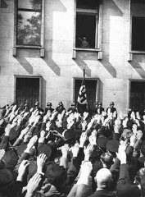
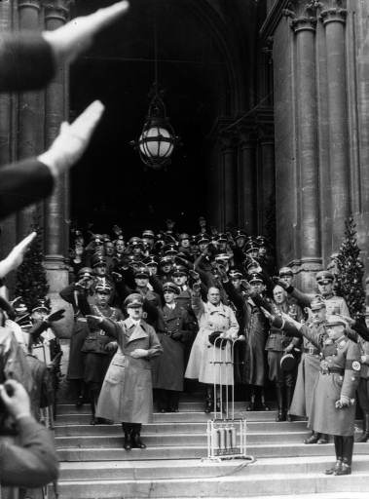
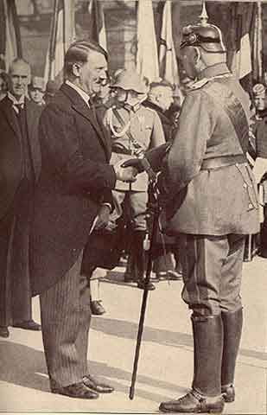
Hitler Appointed Chancellor
January 30, 1933
Adolf Hitler greets a crowd of enthusiastic Germans from a window in the Chancellery building on the day of his appointment.
Hitler in Berlin as new Chancellor of Germany, January, 1933
Newly appointed Chancellor Adolf Hitler shakes hands with German President Paul von Hindenburg.
Notes:
Hitler Appointed Chancellor
Hitler was appointed Chancellor under Article 48 of the Weimar Constitution which granted the President the authority to invoke dictatorial power to protect the democratic order from overthrow (in this case Schleicher’s supposed overthrow), a clause originally inserted to ensure against a feared Communist revolution.
Even with Hitler’s appointment, most high-ranking officers of the army maintained their loyalty to Hindenburg, the revered General Field Marshal of World War I and President of Germany. Looking down on Hitler, they considered him, an ex-lance corporal, a mere enlisted man, to be an ignorant, uneducated, and dangerous adventurer. Still, they recognized that Hitler’s loyal SA militia, the nearly one million jackbooted storm troopers, were dangerous adversaries to their small army, which was restricted to 100,000 by the Treaty of Versailles.
The prevailing wisdom was that the Nazis had been tricked. It was actually thought that the best way to deal with the NSDAP was to let them into power. They would then actually have to make policy. They could no longer be everything to everybody.
Hitler’s deal did not even give him a majority in the Reichstag. His coalition of Nazis and Nationalists (DNVP) had only 248 out of 584 seats in the Reichstag. Still not a majority.
But Hitler wasted no time using his newfound powers to start eliminating the competition.
On his first day as Chancellor, Hitler manipulated Hindenburg into dissolving the Reichstag and calling for new elections on March 5, 1933. He hoped this would bring the Nazis closer to the majority they needed in the Reichstag to pass legislation. His goal was to pass the Enabling Act, a constitutional revision that required a 2/3 majority vote. This would allow him to abolish democracy in a legal fashion.
The Nazis began a campaign to ensure they would win the requisite seats.
Washington, Jan. 20. (AP)—Adolf Hitler's elevation to the Chancellorship in Germany, while something of a surprise to official Washington, apparently created little apprehension as to its effect on international relations.
He is regarded by Washington observers as being surrounded by a conservative cabinet which insures that his threats of past years to scrap treaties will not be carried out. Furthermore, it has now been arranged in Germany so that the Chief Justice of the Supreme Court and not the Chancellor is in line to succeed the President.
Paris, Jan. 30. (AP)—Official quarters, unalarmed by Adolf Hitler's accession to power in Germany, consider that the Nazis likely will be more moderate than speeches have indicated. The French are carefully watching developments and are especially interested in Hitler's attitude concerning disarmament and the League of Nations.
London, Jan. 30. (AP)—Great Britain turned anxious eyes toward the continent today as Adolf Hitler swung into power in Germany.
Whether France would counter the German Nationalist victory with the setting up of a similar Nationalist regime became a question of great interest in political circles.
Rome, Jan. 30. (AP)—Italy enthusiastically acclaimed the accession to power of the Fascist party in Germany, today's newspapers announcing Adolf Hitler's appointment as Chancellor under big headlines on the front pages.
The new development in German politics the newspapers described as a vindication of the Fascist system and an indication that Fascism is spreading through the world.
Papen’s Position
At the formation of Hitler's cabinet on January 30, the Nazis had three cabinet posts to the conservatives' eight. Counting on this majority and on the closeness of Hindenburg and Papen, the vice-chancellor had anticipated "boxing Hitler in." Papen boasted to intimates that "Within two months we will have pushed Hitler so far in the corner that he'll squeak.“
However, Hitler and his allies instead quickly marginalized Papen and the rest of the cabinet. Neither Papen nor his conservative allies waged a fight against the Reichstag Fire Emergency Decree in late February or the Enabling Act in March.
February 22, 1933
Goering declared that Germany was on the brink of civil war. That the Communist party was intending a coup. The police needed help and this was to come from the SA. The SA was sworn in as an auxiliary to the police.

Slide 39
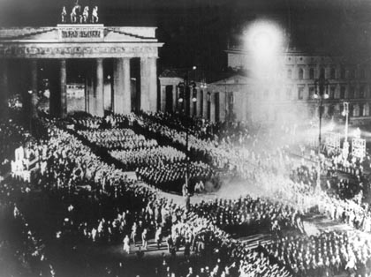
The SA celebrated Hitler's attainment of power on January 30, 1933 with a torch-lit parade in front of the Brandenburg Gate in Berlin.
Notes:
Photo: Torchlight Parade
The SA celebrated Hitler's attainment of power on January 30, 1933 with a torch-lit parade in front of the Brandenburg Gate in Berlin.

Slide 40
I prophesy to you this … by the appointing Hitler Chancellor of the Reich, you have handed over our Sacred German Fatherland to one of the greatest demagogues of all time. This evil man will cast our Reich into the abyss and bring our nation to inconceivable misery. Future generations will damn you in your grave for what you have done.
General Erich Ludendorff, in a telegram to President Hindenburg
Notes:
Quote: Ludendorff’s Prophecy
Only one right wing politician, a man who knew Hitler better than anyone else, saw what was to come. In a telegram to his former wartime colleague, von Hindenburg, the de facto dictator of Germany from 1916-1918 and the figure head of Hitler’s 1923 Putsch predicted this.

Slide 41
Hitler’s Rise to Power
The world is too dangerous to live in – not because of the people who do evil, but because of the people who sit and let it happen. – Albert Einstein
Birth of the Nazi Party
The Weimar Republic
Beer Hall Putsch (November 8-9, 1923)
Nazis Become a Legitimate Party
Hitler Appointed Chancellor (January 30, 1933)
Reichstag Fire (February 27, 1933)
Emergency Decree (February 28, 1933)
Enabling Act (March 23, 1933)
Night of the Long Knives (June 30, 1934)
Hitler Becomes Führer (August 2, 1934)
Notes:
Hitler’s Rise to Power: Breaker Slide – Reichstag Fire/Emergency Decree

Slide 42
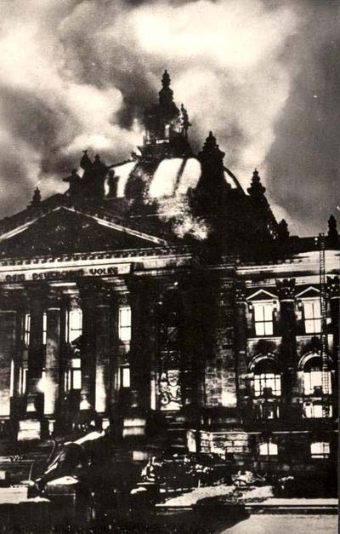
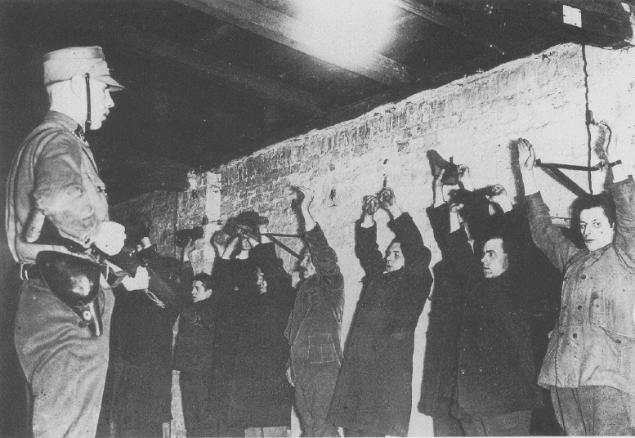
Reichstag Fire
February 27, 1933
Emergeny Decree
February 28, 1933
President Hindenburg was persuaded to issue an Emergency Decree invoking Article 48 of the Weimar Constitution. This gave the Chancellor the authority to impose dictatorial power to protect the democratic order from being overthrown. Members of the Communist Party were arrested.
The Nazis accused the Communists of the arson as well as attempting to overthrow the state. The Nazis would use this event to eliminate all political opposition.
Notes:
Reichstag Fire (February 27, 1933) and Emergency Decree (February 28, 1933)
As Chancellor, Hitler’s first goal was to strengthen his power. The Reichstag Fire provided the excuse he needed.
On February 27, shortly after 9:00 p.m. the Reichstag was set ablaze and reduced to ashes. Without firm evidence, it was put forth that the fire had been set by the Communists as the opening act in an attempt to overthrow the state. A Dutch anarchist, Marinus van der Lubbe, was arrested, charged with arson and later executed.
But was the fire an accident? Some believe the fire was contrived by the newly formed Nazi government to turn public opinion against its opponents and enable the Nazis to assume emergency power. The newly named Propaganda Minister, Joseph Goebbels, was supposedly behind the scene. It was said to have been executed by a Nazi gang, which got into the Reichstag building by a secret tunnel connecting it with the house of Reichstag President Hermann Goering.
Other have concluded that it was neither the NSDAP nor the Communists who set the fire, but one man acting
Regardless, the Nazis would use this event to eliminate all political opposition. Without firm evidence, it was put about that the fire had been set by the Communists as the opening act in their attempt to overthrow the state. Hitler promised to arrest “everyone responsible.” Communist leaders and Communist Reichstag deputies were arrested.
A distraught and half-senile Hindenburg was persuaded to issue an Emergency Decree, “for the protection of the People and the State” (i.e. to protect the country from an alleged Communist revolution). The Emergency Decree invoked Article 48 of the Constitution and gave the Chancellor the authority to impose dictatorial power to protect the democratic order from being overthrown. This decree suspended civil rights, including freedom of assembly and association, freedom of opinion, privacy of letter, post, telegraph and telephone and the guarantee of private property. In addition, the national government was able to assume the powers of the state governments. In other words, Hitler’s government was in complete control.
Almost immediately, the Nazis initiated a wave of terror, murder and torture that effectively cowed thousands of their political rivals, almost all of them Communists, Social Democrats and other liberals.
On March 1, 1933, the Communist Party was banned on the grounds they were preparing a takeover. The police and SA seized all Communist Party buildings and weapons. In the week between the fire and the March 5 elections, many political opponents were arrested and taken into “protective custody,” and detained in hastily set up concentration camps. 4,000 Communists and Social Democrat officials were arrested. Martial law was declared. Hermann Goering, now in charge of the police, replaced senior police officers with his own SA and SS.

Slide 43
Nazis 44%. Number of Reichstag Deputies Elected
Date | Jan 1919 | Jun 1920 | May 1924 | Dec 1924 | May 1928 | Sept 1930 | July 1932 | Nov 1932 | Mar 1933
Total Deputies | 423 | 459 | 472 | 493 | 491 | 577 | 608 | 584 | 647
SPD, Social Democrats | 165 | 102 | 100 | 131 | 153 | 143 | 133 | 121 | 120
USPD, Independent Socialists | 22 | 84
KPD, Communists |  | 4 | 62 | 45 | 54 | 77 | 89 | 100 | 81
Centre Party (Catholics) | 91 | 64 | 65 | 69 | 62 | 68 | 75 | 70 | 74
BVP, Bavarian People’s Party |  | 21 | 16 | 19 | 16 | 19 | 22 | 20 | 18
DDP, Democrats | 75 | 39 | 28 | 32 | 25 | 20 | 4 | 2 | 5
DVP, People’s Party | 19 | 65 | 45 | 51 | 45 | 30 | 7 | 11 | 2
Wirtschafts Partei, Economy Party | 4 | 4 | 10 | 17 | 23 | 23 | 2 | 1
DNVP, Nationalists | 44 | 71 | 95 | 103 | 73 | 41 | 37 | 52 | 52
NSDAP, Nazis |  |  | 32 | 14 | 12 | 107 | 230 | 196 | 288
Others | 3 | 5 | 19 | 12 | 28 | 49 | 9 | 11 | 7
Notes:
Election Chart: March 5, 1933
Note: Red Line on Chart: Indicates the end of free elections.
_______________________________________________________________
With the March 5th elections, the Nazis had hoped to obtain an absolute majority in the Reichstag. The combination of political terror and state-run propaganda gave the Nazis their best election results yet. Despite all the advantages Hitler had created for himself after the Reichstag fire, the Nazis only obtained 44% of the seats. Still not a majority.
Hitler was forced to maintain his coalition with the right wing DNVP to control a 51.8% majority.
Hitler still needed a 2/3’s majority to pass the Enabling Act (a law which would allow him to pass laws without consulting the Reichstag). This was his ultimate goal.
Other measures would have to be taken.

Slide 44
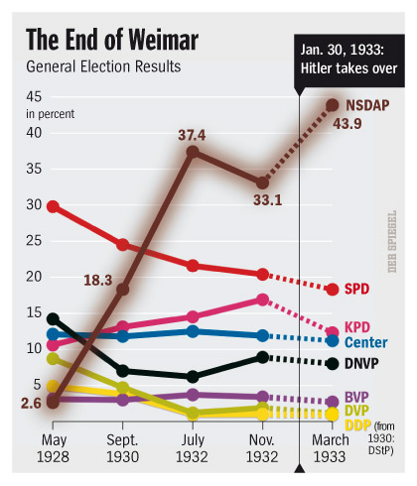
Notes:
Graph: Weimar Election Results

Slide 45
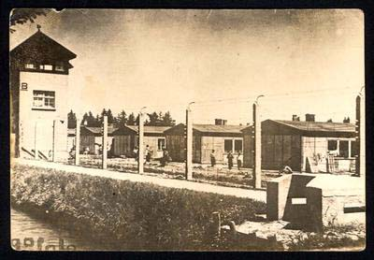
1st Concentration Camp Opens Dachau: March 22, 1933
Notes:
1st Concentration Camp Opens / Dachau – March 22, 1933
The first concentration camp, Dachau, opened on March 22, 1933, primarily to house political opponents of the regime. Theodor Eicke of the SS was Commandant.
Hermann Goering, Minister of the Interior for the State of Prussia, came up with the idea for concentration camps to relieve over-crowding in the jails. He turned to Heinrich Himmler to build the first camp to house some 15,000 political prisoners arrested in Prussia. It was built in an old gunpowder factory in a town 10 miles outside of Munich.
In the first few years of the regime, the concentration camps were instruments of terror, control and punishment, used for the incarceration of political dissidents; later, people defined by the Nazis as “asocial elements” – including the homeless, beggars, gypsies and hardened criminals – were also taken there.

Slide 46
Hitler’s Rise to Power
The world is too dangerous to live in – not because of the people who do evil, but because of the people who sit and let it happen. – Albert Einstein
Birth of the Nazi Party
The Weimar Republic
Beer Hall Putsch (November 8-9, 1923)
Nazis Become a Legitimate Party
Hitler Appointed Chancellor (January 30, 1933)
Reichstag Fire (February 27, 1933)
Emergency Decree (February 28, 1933)
Enabling Act (March 23, 1933)
Night of the Long Knives (June 30, 1934)
Hitler Becomes Führer (August 2, 1934)
Notes:
Hitler’s Rise to Power: Breaker Slide – Enabling Act

Slide 47
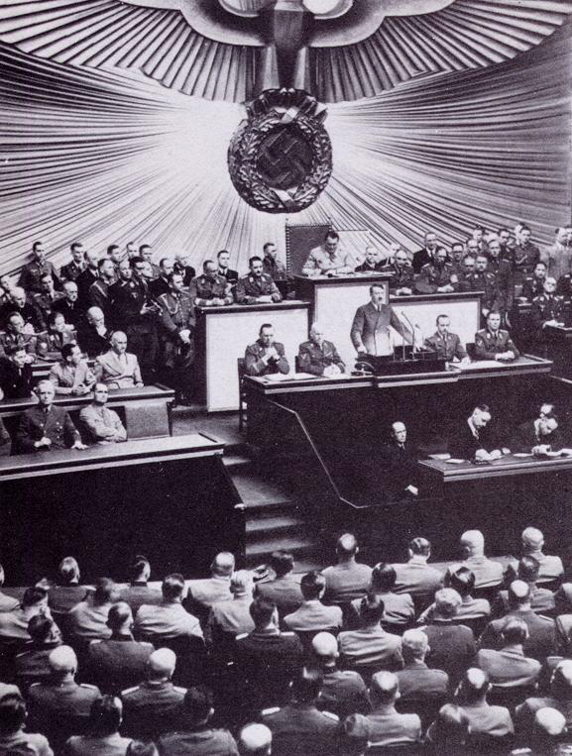
Enabling Act
March 23, 1933
Hitler won the office of Chancellor in a legal fashion, but he was determined to rule Germany without the restraints of a democratically elected parliament.
The Enabling Act was a special power allowed by the Weimar Constitution that gave the Chancellor and his cabinet the power to pass laws by decree for a specified period of time, without Reichstag involvement. It was only to be used in times of emergency.
Because it altered the constitution, passing the Enabling Act required a 2/3 majority vote of the Reichstag. This was achieved by Nazi maneuvering.
The Enabling Act gave Hitler’s government dictatorial powers for four years.
German Reichstag in session.
Notes:
Enabling Act, “Law for Terminating the Suffering of People and Nation” (March 23, 1933)
Although Hitler won the office of Chancellor in a legal fashion, he was determined to rule Germany without the restraints of a democratically elected parliament. For this to happen, the Enabling Act needed to be passed.
The Enabling Act was a special power allowed by the Weimar Constitution that transferred power from the Reichstag to the Cabinet for 4 years, including the power of legislation, budget, approval of treaties and initiation of constitutional amendments. The laws enacted by the Cabinet would be drafted by the Chancellor and “might deviate from the constitution.” In voting for this, the Reichstag would essentially be dissolving itself and making Hitler dictator.
The Enabling Act was only to be used in times of emergency. Because it altered the Constitution, passing the Enabling Act required a 2/3 majority vote of the Reichstag. The Nazis would need the support of other parties in order to get a 2/3 vote.
When the Enabling Act came up for vote in the Reichstag, 107 representatives from the Social Democrats and the Communists were missing. Many were behind bars, while others were too afraid to show up. Just to be on the safe side, Parliamentary President Goering elected not to even acknowledge the 81 seats controlled by the Communists, significantly reducing the number of votes available to the opposition.
In addition, the SA lined the hallways and aisles of the make-shift chamber chanting, “Full power, or else!” and “We want the bill or there will be fire and murder!” These scare tactics intimidated many deputies into voting for the bill.
The Communist vote in the Reichstag was essentially non-existent because so many of the Communist Reichstag deputies had been previously imprisoned after the Reichstag fire while others were prevented from even entering the chamber.
The Catholic Centre Party, at this point the 4th largest party in the Reichstag, decided to vote in favor of the Enabling Act in return for Nazi guarantees regarding the Church’s liberties.
The Social Democratic party was the only party that adamantly refused to vote for the Enabling Act.
Otto Wells, leader of the Social Democrats, told Hitler, “We German Social Democrats pledge ourselves solemnly in this historic hour to the principles of humanity and justice, of freedom and socialism. No enabling act can give you power to destroy ideas which are eternal and indestructible.”
The Enabling Act readily passed (441 – 84) and was dutifully renewed every four years, even through World War II.
Legislative powers of the Reichstag were transferred to Hitler’s cabinet for a period of 4 years. Hitler had equipped his government with dictatorial powers. Within 4 months all political parties had either been banned or dissolved. Germany was now a one-party state. By the time the Enabling Act expired in 1937, the Nazi dictatorship was complete.
The disempowerment of the Reichstag is an example of the way the Nazis usurped Germany’s governing institutions but refrained from destroying them in order to portray the dictatorship as a soundly functioning state.
During the spring of 1933, the other political parties were forced out of existence by a combination of threats and force. As punishment for their dissent, the Social Democrats became the second party banned by the Nazis on June 22. By July 14, all other parties had either been banned or dissolved themselves. Germany was now a one-party state.
A period of Nazi “forced coordination” immediately began in which all German institutions and organizations were either Nazified or disbanded.

Slide 48
Hitler’s Rise to Power
The world is too dangerous to live in – not because of the people who do evil, but because of the people who sit and let it happen. – Albert Einstein
Birth of the Nazi Party
The Weimar Republic
Beer Hall Putsch (November 8-9, 1923)
Nazis Become a Legitimate Party
Hitler Appointed Chancellor (January 30, 1933)
Reichstag Fire (February 27, 1933)
Emergency Decree (February 28, 1933)
Enabling Act (March 23, 1933)
Night of the Long Knives (June 30, 1934)
Hitler Becomes Führer (August 2, 1934)
Notes:
Hitler’s Rise to Power: Breaker Slide – Night of the Long Knives

Slide 49
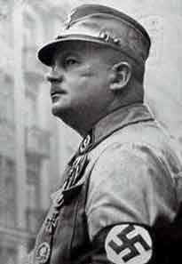
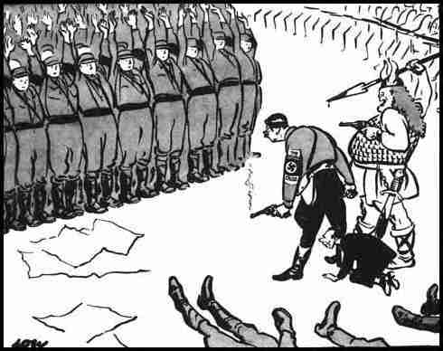
Night of the Long Knives
“The Roehm Putsch”
June 30, 1934
Ernst Roehm, Leader of the SA
Political Cartoon by David Low, July 3, 1934
Notes:
Night of the Long Knives (the Roehm Putsch) - June 30, 1934
Teacher Notes:
This David Low political cartoon from July 3, 1934 shows Hitler (with a smoking gun) and Göring (shown as Thor, the God of War) glowering at terrified SA men with their hands up (not the traditional Nazi salute). Some SA men already lie dead on the ground. The caption reads: 'They salute with both hands now'. Low was fiercely anti-Nazi and portrays Hitler as a brazen murderer keeping his men in check by naked fear. Goebbels is shown as Hitler's poodle.
Sir David Alexander Cecil Low (April 7, 1891 - September 19, 1963) was a New Zealand-born political cartoonist. He worked in his native country before migrating to Sydney, Australia in 1911, and ultimately to London where he made his career and earned fame for his Colonel Blimp depictions and his merciless satirizing of Adolf Hitler and Benito Mussolini. Such stinging depictions led to his work being banned in Italy and Germany.
___________________________________________________________________________________
The SA (Storm Troopers or Brownshirts) were the “thugs” who Hitler had used to help him come to power. They were organized in 1921 as the Nazi’s private army, defending Nazi meetings and attacking opponents. Ernst Roehm, Hitler’s good friend, became Supreme Commander in 1931. By 1934 there were 4.5 million members.
Hitler liked Roehm. He had been one of his first supporters. Roehm had taken part in the Beer Hall Putsch and was one of those imprisoned afterwards. Although found guilty of treason, he was released and dismissed from the German Army. Roehm had been instrumental in obtaining party funds and the SA had played a vital role in destroying the opposition during the elections of 1932 and 1933.
By early 1934, a year after Hitler came to power, the SA's usefulness as a violent, threatening, revolutionary force had effectively come to an end. Hitler now needed the support of the regular Army generals and the big industry leaders to rebuild Germany after the Great Depression, re-arm the military and ultimately accomplish his long range goal of seizing more living space for the German people.
Powerful supporters of Hitler had been complaining about Roehm for some time. Generals were afraid that the SA would absorb the much smaller German Army into its ranks and Roehm would become its overall leader. Industrialists, who had provided the funds for the Nazi victory, were unhappy with Roehm’s socialistic views on the economy and his claims that the real revolution had still to take place. Many people in the party also disapproved of the fact that Roehm and other leaders of the SA were homosexuals.
The average German also feared and disliked the SA brownshirts with their arrogant, gangster-like behavior, such as extorting money from local shop owners, driving around in fancy new cars to show off, getting drunk, as well as beating up and even murdering innocent civilians.
Hitler was aware that Roehm and the SA had the power to remove him as leader, so Hitler ordered Roehm’s destruction in what became known as the Roehm Putsch or the Night of the Long Knives.
In the early morning hours of June 30, 1934, SS forces, followed by Adolf Hitler himself, burst into a country inn near Munich where Roehm and his SA staff had gathered together for a general conference. Roehm and his staff were literally dragged out of their beds and taken to Stadelheim Prison near Munich where Roehm and the entire SA command were summarily executed.
As for Ernst Roehm - on Hitler's order he had been given a pistol containing a single bullet to commit suicide, but he refused to do it, saying "If I am to be killed, let Adolf do it himself." Two SS officers, one of whom was Theodore Eicke, commander of the Totenkopf (Death's Head) guards at Dachau, entered Roehm's cell after waiting fifteen minutes and shot him point blank. Reportedly, Roehm's last words were "Mein Führer, mein Führer!"
There was further “cleansing” in Berlin. Included were:
- Gustav von Kahr, who had opposed Hitler during the Beer Hall Putsch of 1923 - found hacked to death in a swamp near Dachau;
- Father Bernhard Stempfle, who had taken some of the dictation for Hitler's book Mein Kampf and knew too much about Hitler - shot and killed;
- Kurt von Schleicher, former Chancellor of Germany and master of political intrigue, who had helped topple democracy in Germany and put Hitler in to power - shot and killed along with his wife;
- Gregor Strasser, one of the original members of the Nazi Party and formerly next in importance to Hitler;
- Karl Ernst, leader of the SA in Berlin, who was involved in torching the Reichstag building in February, 1933;
- Vice-Chancellor Papen's press secretary;
- Dr. Erich Klausener, Catholic leader.
The exact number of murders is unknown since all Gestapo documents relating to the purge were destroyed. Estimates vary widely from 200 or 250, to as high as 1,000 or more. Less than half of those murdered were actually SA officers.
The men of the SS had unconditionally and loyally obeyed orders to slaughter their comrades of the SA. Hitler justified the murders because, he said, those killed had been scheming with a foreign government to overthrow him. He also claimed that Roehm and others “deserved to die” because of their “corrupt morals.”
The Night of the Long Knives, as the June 30th massacre came to be called was the Nazi regime's baptism by fire. It secured for Hitler the German Army's gratitude and unquestioning loyalty.
Hitler rewarded the SS for its role by raising the SS to independent status as an organization no longer part of the SA. Leader of the SS, Reichsführer Heinrich Himmler now answered to Hitler and no one else. Reinhard Heydrich was promoted to SS Gruppenführer (Lieutenant-General). Roehm was replaced by Victor Lutze as Head of the SA, but from this time on, the SA brownshirts would be diminished and all but disappear as its members were inducted into the regular army after Hitler re-introduced military conscription in 1935.
On July 13, Hitler gave a long speech to the Nazi controlled Reichstag in which he announced that seventy-four had been shot and justified the murders.
If anyone reproaches me and asks why I did not resort to the regular courts of justice, then all I can say is this: In this hour I was responsible for the fate of the German people, and thereby I became the supreme judge of the German people.
It was no secret that this time the revolution would have to be bloody; when we spoke of it we called it 'The Night of the Long Knives.' Everyone must know for all future time that if he raises his hand to strike the State, then certain death is his lot.
By proclaiming himself the supreme judge of the German people, Hitler in effect placed himself above the law, making his word the law, and thus instilled a permanent sense of fear in the German people.
The German Army generals, by condoning the unprecedented events of the Night of the Long Knives, effectively cast their lot with Hitler and began the long journey with him that would eventually lead them to the brink of world conquest and later to the hanging docks at Nuremberg after the war.
The German conspirators who attempted to overthrow Hitler and the Nazi regime from 1938 to 1944 never forgot the June 30th massacre. Many held it up as proof that Hitler would stop at nothing to achieve his demonic ends and could only be removed in the same manner.

Slide 50
Nazi Intentions Revealed
Since when do you have to agree with people to defend them from injustice?
- Lillian Hellman
Anti-Jewish Policies
Boycott of Jewish Shops: April 1, 1933
Nazi Book Burnings: May 10, 1933
Notes:
Nazi Intentions Revealed
Teacher Note:
One should note how quickly anti-Jewish actions began after Hitler assumed power. This included the implementation of anti-Jewish policies as well as the Boycott of Jewish Shops and Book Burnings which all occurred within Hitler’s first 4 months in power.
This should have been the time for protest from the German constituency as well as foreign governments. All of these acts were documented in U.S. as well as other foreign newspapers. Protests did occur in the U.S., initiated by the Jewish community, but fell on deaf ears.

Slide 51
Hitler’s Rise to Power
The world is too dangerous to live in – not because of the people who do evil, but because of the people who sit and let it happen. – Albert Einstein
Birth of the Nazi Party
The Weimar Republic
Beer Hall Putsch (November 8-9, 1923)
Nazis Become a Legitimate Party
Hitler Appointed Chancellor (January 30, 1933)
Reichstag Fire (February 27, 1933)
Emergency Decree (February 28, 1933)
Enabling Act (March 23, 1933)
Night of the Long Knives (June 30, 1934)
Hitler Becomes Führer (August 2, 1934)
Notes:
Hitler’s Rise to Power: Breaker Slide – Hitler Becomes Führer

Slide 52
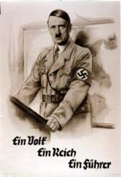
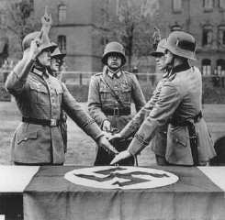
Hitler Becomes Führer
August 2, 1934
With President Paul von Hindenburg's death, Hitler consolidated power by joining the offices of Chancellor and President. He assumed the title of Führer (leader) and Reich Chancellor of the German nation.
Placing one hand upon the Nazi flag and raising the other in obedience, these German soldiers swear their allegiance to the Führer.
"One People, One Empire, One Führer."
Notes:
Hitler Becomes Führer: August 2, 1934
Upon Hindenburg’s death on August 2, 1934, Hitler combined the offices of President (the head of state) and Chancellor (the head of the government) and assumed the title of Führer and Reich Chancellor (Leader and Chancellor).
The day of the President’s death, the cabinet ordered a plebiscite (direct vote) for August 19, 1934 in order for the German people to approve the combination of the two offices. About 95 percent of registered voters in Germany went to the polls and gave Hitler 38 million votes (90%). Hitler could now claim he was Führer of the German nation with the overwhelming approval of the people.
The following day, August 20, 1934, the cabinet decreed the "Law on the Allegiance of Civil Servants and Soldiers of the Armed Forces." All public employees – the military, the civil service, police, teachers, and the judiciary – now had to take a loyalty oath not to the constitution, not to their country, but to Hitler, the Führer. The Nazis’ top jurist proclaimed, “In the old days we used to ask, ‘What is the law?’ Now we ask only, ‘What does the Führer want?’” Thus Hitler became the State and Germans transferred their customary deference and loyalty from the German nation to Hitler personally.
Hitler came to power legally, but not as a result of an election victory or any wave of popular enthusiasm. The Nazis had never won over 37% of the popular vote in a free election. Hitler assumed the reins of government only with the assistance of the old conservative elites, who naively continued to believe that Hitler would pay them deference. What gave Hitler his break was the colossal miscalculation that Hitler could, as a junior politician, be tamed and used by the Establishment. Once in office, Hitler proved to be uncontrollable. He astounded and overwhelmed those who felt they had trapped him. Hitler made legal what others considered to be illegal. Sensible people were sure that Hitler could not last long, that decency, rationality, and political order would reassert themselves. What followed was a terrifying indictment of the power of human indifference and passivity.

Slide 53
Democracy is a process, not a static condition. It is becoming rather than being. It can easily be lost, but never is fully won. It’s essence is eternal struggle.
William H. Hastie, 1st black Federal Judge
What followed was a terrifying indictment of the power of human indifference and passivity.
Notes:
Quote: William H. Hastie, 1st black Federal judge
Democracy is a process, not a static condition. It is becoming rather than being. It can easily be lost, but never is fully won. It’s essence is eternal struggle.
- William H. Hastie, 1st black Federal judge

Slide 54
Myth or Fact: Adolf Hitler was elected to power.
Myth or Fact: Adolf Hitler was elected to power.
Hitler never received more than 37% of the popular vote (in March 1932 Presidential election) in the honest elections that occurred before he became Chancellor. He would never have seen the light of day had the German Republic been truly democratic.
Myth or Fact: Hitler’s rise to power was inevitable.
Myth or Fact: Hitler’s rise to power was inevitable.
Hitler’s rise to power was not inevitable. It was due to numerous factors:
Fatal flaws in the Weimar Republic constitution.
German leaders who had a weak devotion to democracy, came in actively plotting to overthrow it.
Events of the Great Depression.
A half-senile President Hindenburg.
Incompetent competition.
The occurrence of unnecessary backroom deals just as the Nazis were starting to lose popular appeal and votes.
Notes:
Myth of Fact?

Slide 55
Works Cited
Bergen, Doris L. War and Genocide, A Concise History of the Holocaust. New York: Barnes and Noble, 2007.
Bullock, Alan. Hitler: A Study in Tyranny. New York: HarperCollins, 1962.
The History Place. http://www.historyplace.com/worldwar2/riseofhitler/index.htm .
St. Martin’s College. http://www.history-ontheweb.co.uk/topic/topic_weimar.htm .
Shirer, William. The Rise and Fall of the Third Reich. New York: Simon & Schuster, 1960.
The Shoah Education Project. http://www.shoaheducation.com/weimar.html .
Suite 101.com. http://weuropeanhistory.suite101.com/article.cfm/the_weimar_republic .
The U.S. Holocaust Memorial Museum. www.ushmm.org .
The Walter Benjamin Research Syndicate: New College of California. http://www.wbenjamin.org/weimar.html.
Western New England College. http://mars.wnec.edu/~grempel/courses/germany/lectures/23weimar_collapse.html .
Yad Vashem. www.yadvashem.org .

